Slide 1
Application and Multi-Server Management
Cristian Lefter
SQL Server MVP

Slide 2
Agenda
Introducing Application and Multi-Server Management
Working with Data-Tier Applications

Slide 3
Introducing Application and Multi-Server Management

Slide 4
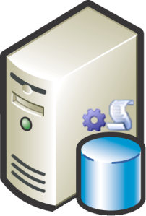

SQL Server Management Trends
Under-utilized hardware
Hardware computing capacity
Number of database apps
Overburdened administrators
Number of DBAs
1990
2000
2010

Slide 5
Challenges: Management
Ever-increasing number of servers and applications
Lack of enterprise-wide view of SQL Server health
  Server/instance
  Application
Difficult resource planning

Slide 6
Challenges: Development
Limited T-SQL development tooling in earlier Visual Studio versions
Difficult deployment
  Need to package applications with databases
  Need to record deployment intent
  Handing off T-SQL scripts is error-prone
  Upgrades are challenging

Slide 7
Application and Multi-Server Management
Organizations need to manage many instances
SQL Server 2008 investments
  Central management server
  Local groups and centrally-managed groups
    Queries against server groups
    Policy evaluation against server groups
SQL Server 2008 R2 investments
  SQL Server Utility
  Data-tier Application
  New T-SQL IDE in Visual Studio 2010

Slide 8


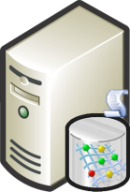

SQL Server Utility
Provides unified view of an organization’s SQL Server usage
Shows health of
  SQL Server instances
  Data-tier applications
  Database files, filegroups and volumes
Provides resource monitoring
  CPU utilization
  Storage space
SQL01
SQL02
SQL03
SQL05
DBA
SQL04
Management Studio
Control
Point
Managed Instances

Slide 9
Creating a Utility Control Point
Demo

Slide 10
Working with Data-Tier Applications

Slide 11
Data Application Vision
T-SQL development experience should be
  First-class during development
  Productive
  Based on understanding of deployment intent
Common tooling from Visual Studio 2010
  Rich T-SQL editor
  Intellisense
  Debugger
  Deep integration with project system

Slide 12
Data-Tier Application Component
Unit of deployment for T-SQL applications
Defines contents of the application
Wraps deployment intent as policies
Simplifies deployment and administration
  Install
  Uninstall
  Upgrade
  Repair (not in V1)
Data-Tier Application Component
Schema
LOGICAL
Tables
Views
Constraints
Sprocs
UDFs
PHYSICAL
Users
Logins
Indexes
DEPLOYMENT PROFILE
Requirements
Management Policies
Failover Policies

Slide 13
Data-Tier Application
Data-Tier Application
Deployed instance of a Data-tier application component
Maps to a database
Has direct and strict relationship with .dacpac file definition
Schema
DATABASE SCHEMA
Tables
Views
Constraints
Sprocs
UDFs
Users
Logins
Filegroups
PROPERTIES & METADATA
Requirements
Management Policies
Failover Policies

Slide 14
Data-Tier Applications in Visual Studio 2010
Business goals and vision
  First-class T-SQL/DAC development experience in VS
    “Develop, Deploy, Manage”
  Common tools and experiences in SSMS and VS
    Editor, IntelliSense, debugging, …
Key scenarios
  Deep integration with project system
  Highly productive T-SQL editor (IntelliSense, debugger, …)
  DAC Projects in Pro+ SKUs
  Application Lifecycle Management scenarios in Premium & Ultimate SKUs

Slide 15
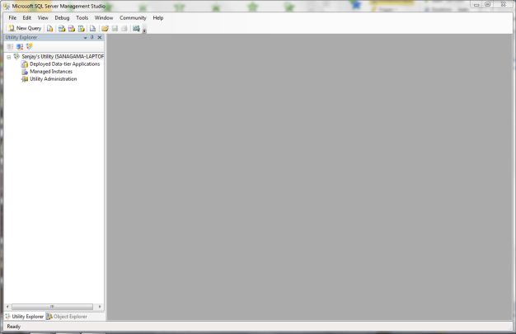
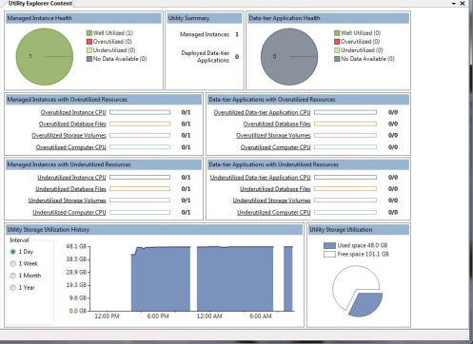
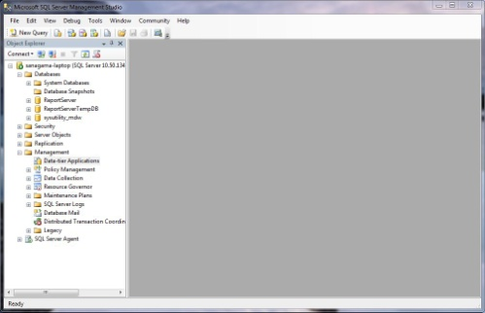
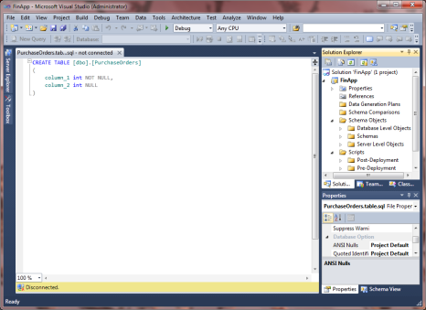
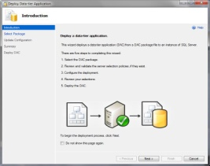
DEVELOP
DEPLOY
MANAGE
SQL Server Management Studio
1
Deploy /
upgrade DAC
Reverse- engineer DAC
2
SQL Server Management Studio
9
4
DBA
8
Control
Point
Visual Studio 2010
Manage, register, uninstall, extract, upgrade DAC
Create policies
DBA
7
3
Deploy /
upgrade DAC
Developer
Compile
& build
Hand off to DBA
Prod DB
6
5
.dacpac
Managed Instances

Slide 16
Data-Tier Application Elements
Application properties (appname, version)
Database object definitions
Instance-level object definitions (logins, collations, compatibility level)
Server-selection policy
Files & scripts (pre/post-deployment scripts)
.dacpac is a .zip file
  Contains multiple XML files
  Does not contain any user data

Slide 17
Supported Objects
Only the most common objects supported for authoring/editing
Applications with unsupported objects are not supported
Views | Database roles
Clustered indexes | Schemas
Non-clustered indexes | Logins
T-SQL stored procedures | Users
Check constraints | Computed columns
Primary key constraints | Triggers (DML)
Foreign key constraints | Alias types
Unique constraints | Table types
Table-valued functions | Scalar functions

Slide 18
Initial Deployment
Supply name of instance for deployment
Server-selection policy is checked
Database and objects are created
  One data file (3MB and 1MB unlimited growth)
  One log file (1MB and 10% growth, limited to 2TB)
  Recovery model taken from instance defaults

Slide 19
Creating Data Tier Applications
Demo

Slide 20

Resources
Managing the SQL Server Utility
  http://msdn.microsoft.com/en-us/library/ee210557(SQL.105).aspx
Troubleshooting the SQL Server Utility
  http://msdn.microsoft.com/en-us/library/ee210592(SQL.105).aspx
Reducing Noise in CPU Utilization Policies
  http://msdn.microsoft.com/en-us/library/ee210560(SQL.105).aspx
Data-tier Application Tutorials
  http://msdn.microsoft.com/en-us/library/ee210554(SQL.105).aspx
Data-tier Applications in SQL Server 2008 R2 whitepaper
  http://msdn.microsoft.com/en-us/library/ff381683.aspx

Slide 21

© 2010 Microsoft Corporation. All rights reserved. Microsoft, Windows, Windows Vista and other product names are or may be registered trademarks and/or trademarks in the U.S. and/or other countries.
The information herein is for informational purposes only and represents the current view of Microsoft Corporation as of the date of this presentation. Because Microsoft must respond to changing market conditions, it should not be interpreted to be a commitment on the part of Microsoft, and Microsoft cannot guarantee the accuracy of any information provided after the date of this presentation.
MICROSOFT MAKES NO WARRANTIES, EXPRESS, IMPLIED OR STATUTORY, AS TO THE INFORMATION IN THIS PRESENTATION.

