Slide 1

The Knowledge Worker’s Perspective: Self-Service of BI with Microsoft PowerPivot and Office 2010
Rafal Lukawiecki
Strategic Consultant, Project Botticelli Ltd
rafal@projectbotticelli.com

Slide 2

Objectives
Understand how knowledge workers uses self-service BI
Introduce Excel Analytics and PowerPivot
This seminar is based on a number of sources including a few dozen of Microsoft-owned presentations, used with permission. Thank you to Chris Dial, Tara Seppa, Aydin Gencler, Ivan Kosyakov, Bryan Bredehoeft, Marin Bezic, and Donald Farmer with his entire team for all the support.
The information herein is for informational purposes only and represents the opinions and views of Project Botticelli and/or Rafal Lukawiecki. The material presented is not certain and may vary based on several factors. Microsoft makes no warranties, express, implied or statutory, as to the information in this presentation.
Portions © 2010 Project Botticelli Ltd & entire material © 2010 Microsoft Corp. Some slides contain quotations from copyrighted materials by other authors, as individually attributed or as already covered by Microsoft Copyright ownerships. All rights reserved. Microsoft, Windows, Windows Vista and other product names are or may be registered trademarks and/or trademarks in the U.S. and/or other countries. The information herein is for informational purposes only and represents the current view of Project Botticelli Ltd as of the date of this presentation. Because Project Botticelli & Microsoft must respond to changing market conditions, it should not be interpreted to be a commitment on the part of Microsoft, and Microsoft and Project Botticelli cannot guarantee the accuracy of any information provided after the date of this presentation. Project Botticelli makes no warranties, express, implied or statutory, as to the information in this presentation. E&OE.

Slide 3
Microsoft Office Excel 2010

Slide 4

Excel Analytics
Excel’s BI features:
  Deep Analysis Services integration
  New Visualisations
  Advanced Filtering
  Data Mining
  PowerPivot for Excel 2010
    Including DAX

Slide 5
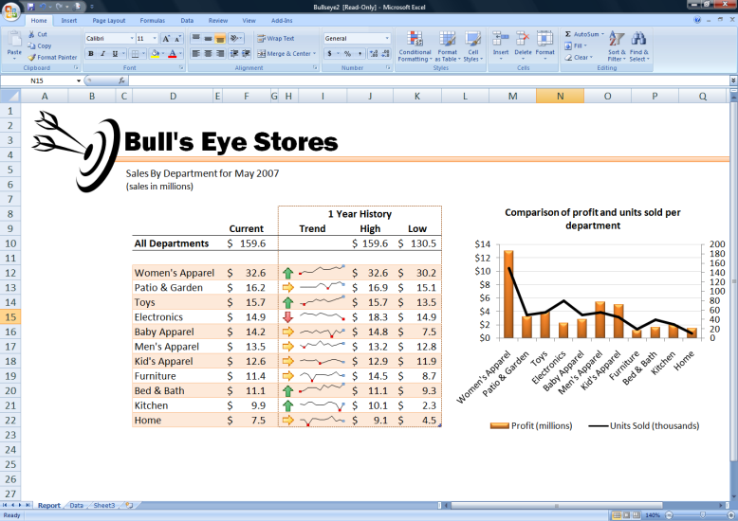
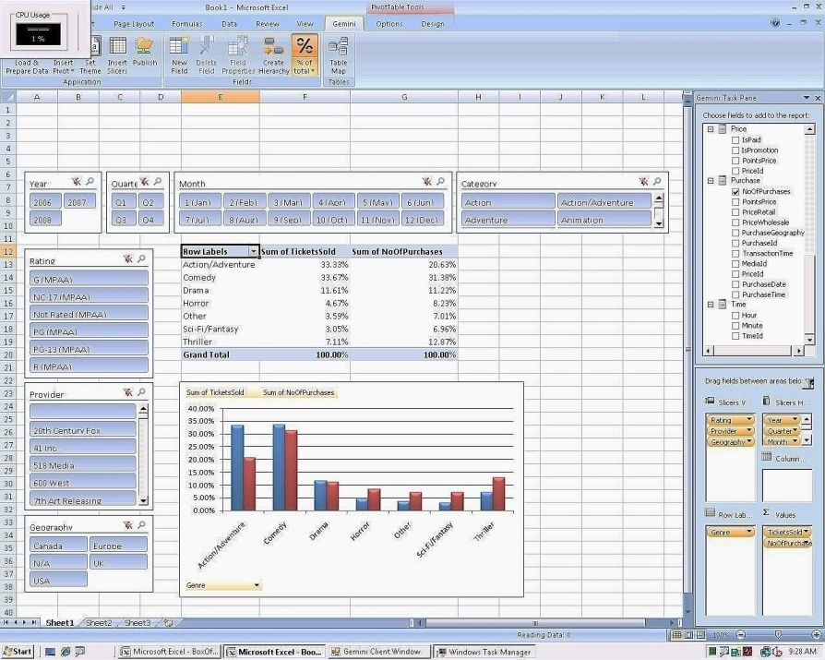
New Visualizations and Interactivity
Slicers enable easier navigation
Improved formatting and charts

Slide 6
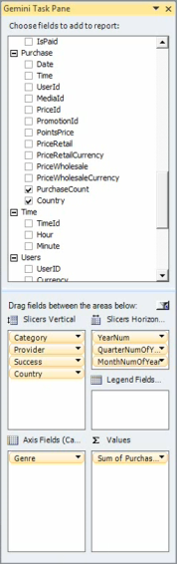
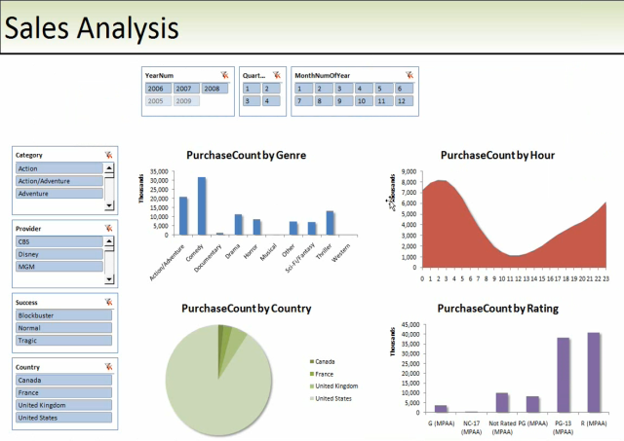


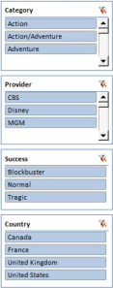

Interactive Slicing and Dicing
Excel 2010 and Excel Services
Interactive slicers enable users to look at the data from various directions in Excel 2010 and in the browser through PowerPivot for SharePoint and Excel Services.

Slide 7
Excel Services in SharePoint
Part of SharePoint Server 2010
  A server version of Excel: security, high performance computing, enterprise scalability
  For: dashboards, reports etc
  Why?
    One version of the truth
    Thin-client and collaboration
    Server based calculations
    Enabling collaborative PowerPivot
Alternative choice: Excel Web Application
  Enables collaborative editing in the browser

Slide 8
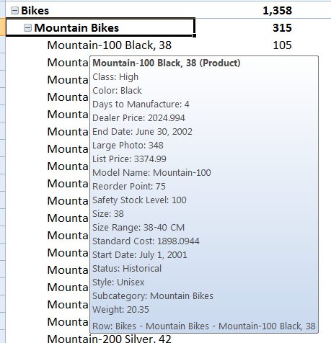
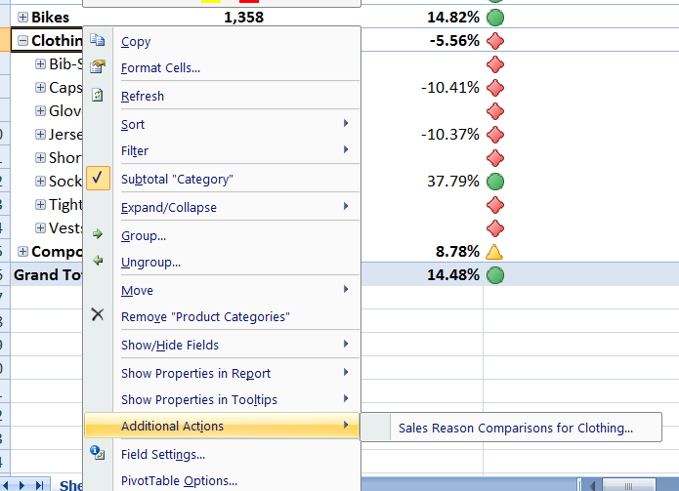
Excel and Multidimensional Data
Pivot Tables and Pivot Reports
Support for KPIs
Data from OLAP or PowerPivot!

Slide 9
demos
Pivot Reports and Charts for Multidimensional Analysis

Slide 10

Data Mining Add-Ins for Excel
Free add-in for Excel 2007 (and Visio)
  Works with 32 bit edition of Office 2010
Requires SQL Server Analysis Services
Analyze Tab – simpler to use
Data Mining Tab – full power

Slide 11
demos
Finding Outliers with Data Mining
Forecasting Sales with Time Series
Market Basket Analysis

Slide 12
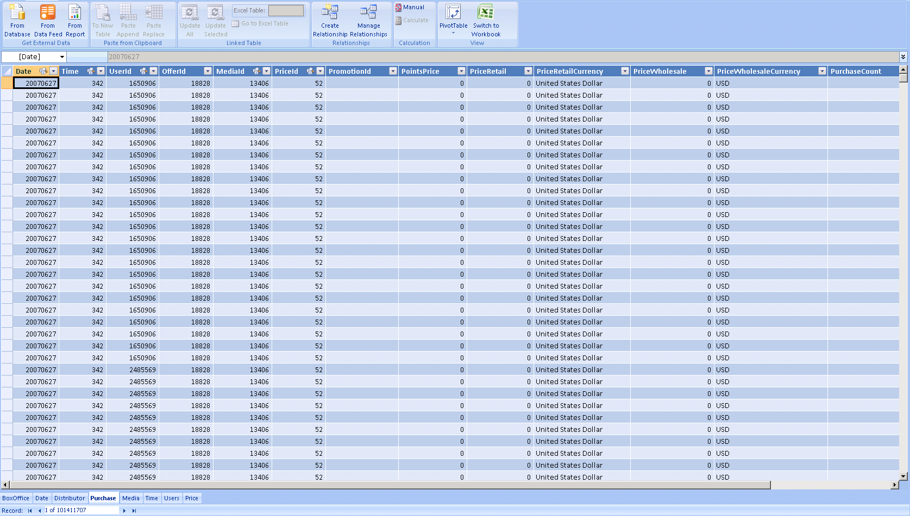

PowerPivot for Excel 2010
Ad-hoc large data analysis
In-memory Database
  Like Analysis Services
Fast, compressed, interactive
User calculation
Data integration
No IT Dept support needed
More in the last session of the day ☺

Slide 13
demos
Slicing data with PowerPivot
Analysing a large volume of data
Creating sparklines and slicers

Slide 14
















Reporting Services as a Data Source
Report-Based
Data Feeds
Data Import
Published Reports
Publishing
SharePoint Farm
OLTP and OLAP Data Sources

Slide 15
demos
Report as a Data Source for Analysis

Slide 16
PowerPivot on SharePoint 2010
Manageability

Slide 17
PowerPivot for SharePoint 2010
Managed Self-Service Business Intelligence
Collaborative, shared gallery of PowerPivots
IT Pro management
  Lifecycle & Workflow
  Server Resource Management

Slide 18

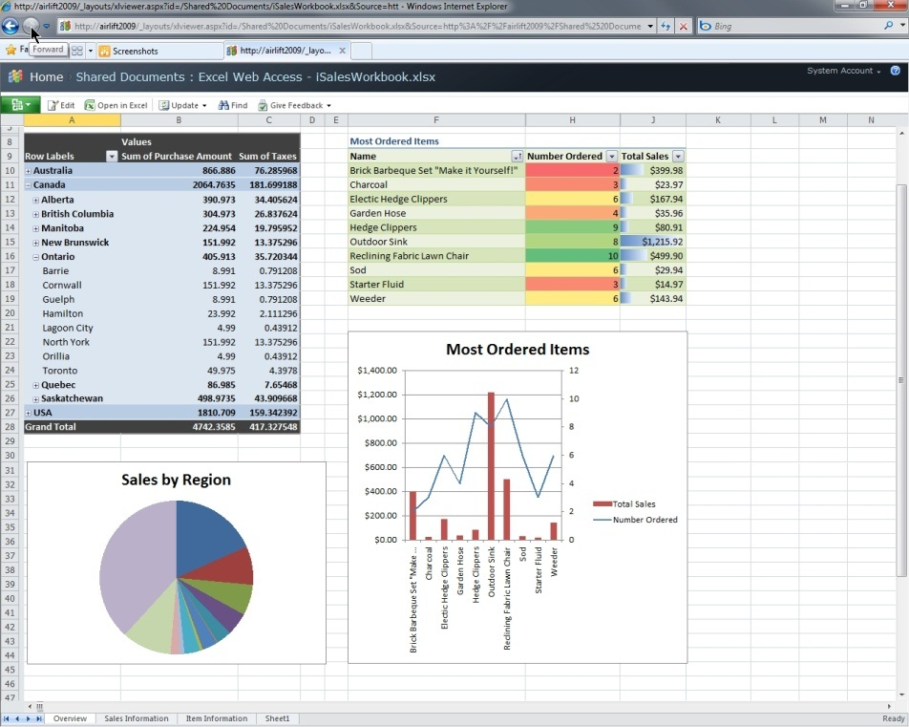
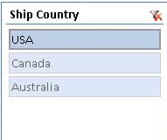
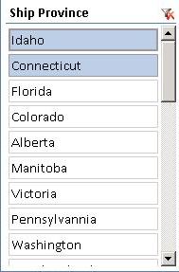
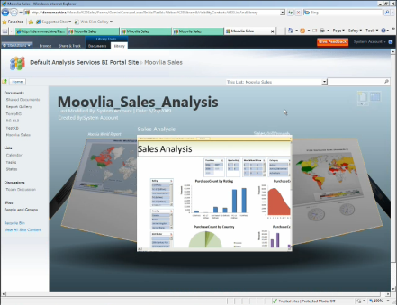
Share Insights
Common view of organizational performance
Workbook data can be refreshed manually or automatically
PowerPivot capabilities grant access to unlimited data secured in SharePoint
Publish and share rich
workbooks to SharePoint
Same rich fidelity with web browser including Ribbon and Excel functions

Slide 19
demos
PowerPivot for SharePoint: Uploading Documents to Server
Galleries

Slide 20
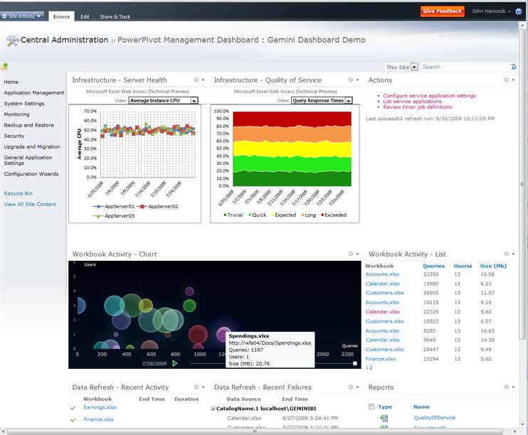
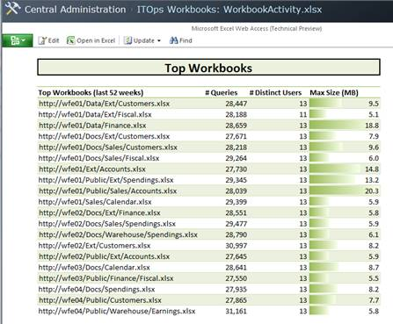
Managing the BI Environment
User driven application administration and monitoring
Manage and facilitate access to secure organizational data
Simplify management of BI content using IT Operations Dashboard
for SharePoint
Notes:
Point of slide: How MSBI enables IT to easily manage the BI environment
Easily manage the self-service environment
Self-service is great for end users, but IT still needs to control access, security, and quality. Enhanced administration capabilities are available within the new administration dashboard within Microsoft SharePoint. The administration dashboard allows IT to monitor and govern the content that workers create using self-service tools. IT can track, review, and report on thousands of users, so they can determine the content being used, evaluate the reports being accessed, and identify other access and frequency trends, so that they can more quickly shift resources and support to the areas of greatest need.

Slide 21
demos
PowerPivot Management Dashboard
Anticipating a self-created BI that can become an organisational concern

Slide 22







PowerPivot Infrastructure Overview
Excel Services
Power User
PowerPivot Mid-Tier
Excel, RB,
PerfPoint
SharePoint Farm
AS Engine
PowerPivot Add-In
WFE
Data Sources
App Servers
Standard User
Content dBs
Browser

Slide 23
PowerPivot Infrastructure: Excel
Excel Services
Power User
Use of IMBI Engine: In-Memory Column-Based store
Once data is imported, all calculations are performed on client
Excel now has it’s own local SSAS engine
Added Excel power functions for Gemini called DAX (Data Analysis eXpressions)
Use of new compression algorithm to significantly compress the data ~ 10:1
Added slicer functionality: not just for UI but for smoother SharePoint integration
Gemini Mid-Tier
Excel, RB,
PerfPoint
SharePoint Farm
Gemini Engine
PowerPivot Add-In
WFE
Data Sources
App Servers
Standard User
Content dBs
Browser

Slide 24
PowerPivot SharePoint Integration:
ECS Viewing
Excel Services
Power User
PowerPivot Mid-Tier
Excel, RB,
PerfPoint
SharePoint Farm
AS Engine
WFE
Excel Web Access
Data Sources
App Servers
Standard User
Content dBs
Browser

Slide 25
PowerPivot SharePoint Integration:
Server Action
Excel Services
Power User
PowerPivot Mid-Tier
Excel, RB,
PerfPoint
SharePoint Farm
AS Engine
WFE
Excel Web Access
Data Sources
App Servers
Standard User
Content dBs
Browser

Slide 26
Conclusions

Slide 27
Summary
Office 2010 makes BI easy to access by every knowledge worker
Vision of Self-service BI starts with PowerPivot
SharePoint & PowerPivot for manageable BI
Analyse some data using PowerPivot
  Get it from: www.powerpivot.com
  Want lots of data? www.infochimps.org

Slide 28

© 2010 Microsoft Corporation & Project Botticelli Ltd. All rights reserved.
The information herein is for informational purposes only and represents the opinions and views of Project Botticelli and/or Rafal Lukawiecki. The material presented is not certain and may vary based on several factors. Microsoft makes no warranties, express, implied or statutory, as to the information in this presentation.
Portions © 2010 Project Botticelli Ltd & entire material © 2010 Microsoft Corp. Some slides contain quotations from copyrighted materials by other authors, as individually attributed or as already covered by Microsoft Copyright ownerships. All rights reserved. Microsoft, Windows, Windows Vista and other product names are or may be registered trademarks and/or trademarks in the U.S. and/or other countries. The information herein is for informational purposes only and represents the current view of Project Botticelli Ltd as of the date of this presentation. Because Project Botticelli & Microsoft must respond to changing market conditions, it should not be interpreted to be a commitment on the part of Microsoft, and Microsoft and Project Botticelli cannot guarantee the accuracy of any information provided after the date of this presentation. Project Botticelli makes no warranties, express, implied or statutory, as to the information in this presentation. E&OE.

