Slide 1

Windows Embedded POSReady 2009 seminarium
www.elbacom.com
Gergely Rózsa
Zsolt Szanya

Slide 2
Contacts
Gergely Rozsa
g.rozsa@elbacom.com
+36 30 5246783
www.elbacom.com

Slide 3




Industry Trends
Devices
Devices continue to be more connected (At home, work, and in the field)
OEMs need to incorporate larger number of more complex applications into the embedded device
Deployed Devices need to grow in functionality; applications from a variety of sources can create a richer end-user experience
Devices need to work “Better together” with other devices and technologies
Version 1
Can Do…
Version 2
Can Do…
Version 3
Can Do…
Devices require increased features and functionality to stay competitive

Slide 4






Microsoft Embedded Systems
Windows Embedded
Compact
Windows Embedded
POSReady

Slide 5
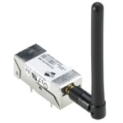

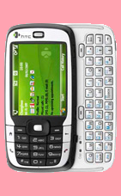
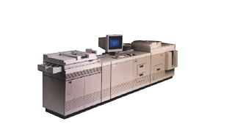
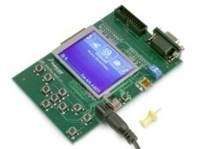
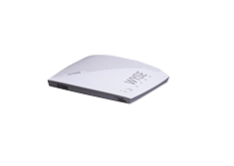

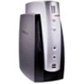
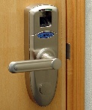
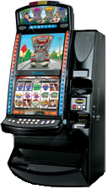

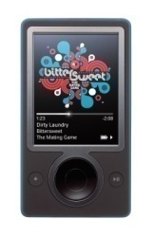
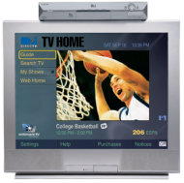


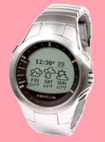




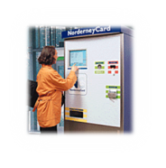
Windows Mobile
Smartphones and PDAs
Industrial automation
Industrial
automation
Network sensors
Office automation
Windows Automotive
Thin clients
Windows terminals
Thin clients
Secondary
displays
Gambling
machines
Medical
devices
Portable Media Player
Set-top Boxes
VoIP Phones
Security
Hardware Resources
Remote controls
Rugged
handheld
Set-top Boxes
Point of sale
ATMs / Kiosks
Wearable devices
POSReady
Compact
Functionality

Slide 6

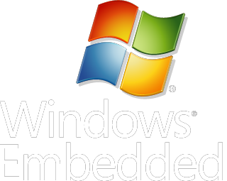

Who's who?
Compact
POSready
Notes:
A brand name for Microsoft‘s embedded technologies & tools

Slide 7
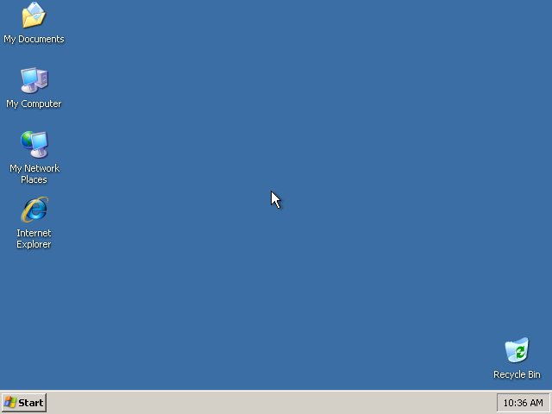
Find the differences among these 3 screenshots
Microsoft Embedded Channel
Windows XP Pro for Embedded Devices
Windows Vista Embedded
WEPOS / Windows POSReady 2009
Windows Embedded Standard
Windows XP Embedded

Slide 8
Solution
Windows
for Embedded Devices
Microsoft Embedded Channel
Windows XP Pro for Embedded Devices
Windows Vista Embedded
WEPOS / Windows POSReady 2009
Windows Embedded Standard
Windows XP Embedded
Windows Embedded
POSReady 2009

Slide 9
What is POSReady?
A standard, retail-optimized OS platform for retail Point of Service devices
  Only POS platform to provide Plug-n-Play support for peripherals
  Based on Windows XP Embedded with Service Pack 3
  Reduced OS footprint
  Available till 2024 in Windows Embedded channel
First of a series of retail-focused investments from Microsoft
Notes:
Windows Embedded for Point of Service is the code name for a version of Windows currently under development that is optimized for retail Point of Service devices. It is based on the technologies available in Windows XP Embedded with Service Pack 2.
Windows Embedded for Point of Service is not the only Microsoft solution for retail store devices. While its rich functionality is most appropriate for full-featured point of sale terminals, self-service kiosks and self-checkout systems, Windows CE also offers a great solution for those building low-end, less functional electronic cash registers, retail peripherals, and mobile handheld devices such as scanners and inventory control devices.
It is also important to note that the development of "Windows Embedded for Point of Service" is the first of many retail-industry focused investments by Microsoft. Current version: Windows Embedded POSReady 2009
Having introduced Windows Embedded POSReady 2009 at a high level, I’ll now drill down into some of the specific benefits and features you should consider in evaluating it as the OS for your retail Point of Service device.

Slide 10
Windows Embedded POSReady
Overview
Installation
  Directly on Target Device
  Setup Wizard
  All features now on one DVD
Some Embedded Features
  FBWF
  USB 2.0 Boot
5
4
3
2
1
Cost
Flexibility
Knowledge

Slide 11
Built in new features
Add/Remove Windows Components after deployment
File-Based Write Filter (integrated per default)
USB
  USB Boot
  Install to USB
  Install from USB
Microsoft Silverlight 2.0 Support (3.0)
.NET Framework 3.5 Support
Windows Media Player 11
Network Access Protection (NAP)
IE7.0 (8.0)

Slide 12

POSReady Installation
Setup
  Use Setup DVD on your target device
  Boot from DVD
  Run through the setup wizard
  Burn your customized CD
  Templates available

Slide 13
POSReady MUI Packs
(32 languages)
Can be added / removed at image runtime
Install MUI Pack from DVD
Select MUI Pack
Install / Uninstall

Slide 14

Installation process
Microsoft Embedded Channel
Windows XP Pro for Embedded Devices
Windows Vista Embedded
Windows Embedded Standard
Windows XP Embedded
WEPOS / Windows POSReady

Slide 15

What you need before installation
Installation disc (contact Elbacom)
25 character PID
    For 120 day evaluation key, please register at Microsoft
    http://www.microsoft.com/windowsembedded/en-us/products/readyproducts/posready/default.mspx
    To purchase runtime license, contact Elbacom
Windows XP driver of special storage drive(RAID,etc..), you want the OS to install to.
COA sticker

Slide 16
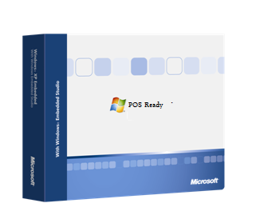
Windows POSReady
Installation overview
333MHz CPU
Minimum 64MByte Ram
(without pagefile 512MByte)
510MByte harddisk space

Slide 17
Windows POSReady
Adding drivers not included into SP3
  Add mass-storage drivers by pressing F6
    Press F6 at the beginning of the process if prompted
    Press S and enter a floppy disc containing the drivers
    Select the desired driver by hitting enter
    Press S again to add another driver or press Enter to continue the installation
    During the setup process you can enter mass-storage drivers aswell... (If the driver is not recognized automatically, you can define it manuall.)

Slide 18
Windows POSReady
Adding drivers not included into SP3
  Add mass-storage drivers by using an XML driver file
    Use INFIMPORTER utility to generate XML driver file from the .INF file.
    (<AdditionalDevice> , <AlwaysInstall>)
    Start setup
    Press any key to enter setup launcher command prompt
    Setup.exe /devicefile:pathname\driver_file.xml

Slide 19
Windows POSReady
Adding drivers not included into SP3
  If you install from a USB flash drive
    Create a USB setup disk using the installation DVD wizard.
    After the process is finished, create a „Drivers” directory in the root.
    Copy your mass storage drivers to the Drivers directory

Slide 20
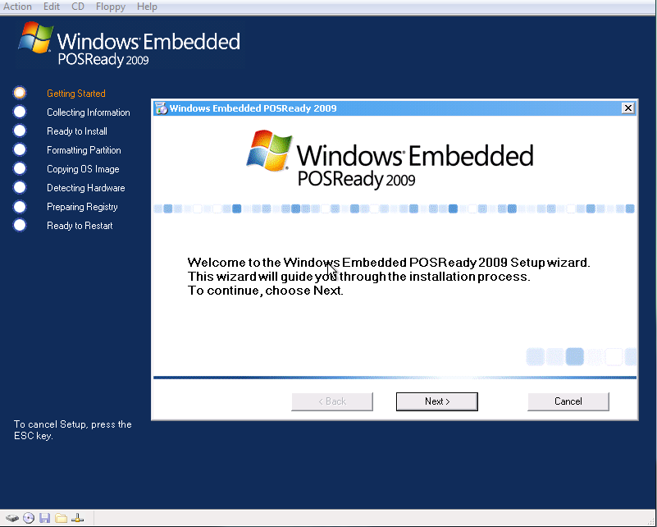
Simple XP_Pro like installation process
OPK or Evaluation DVD

Slide 21
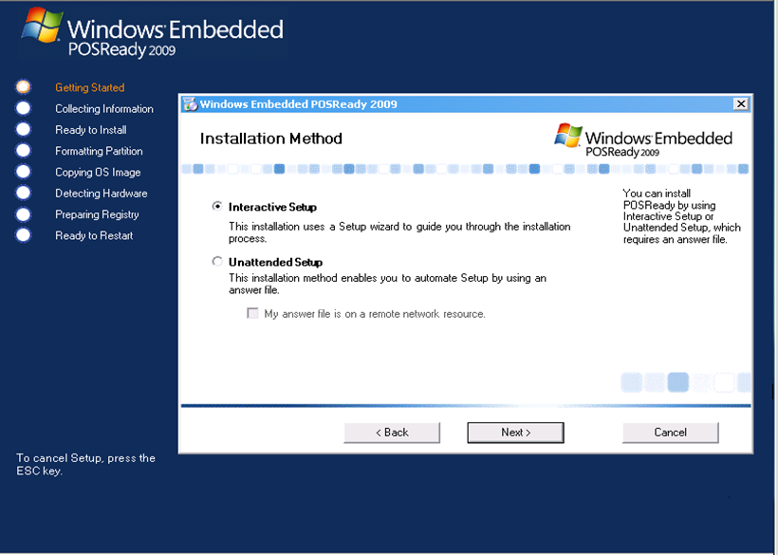
Unattended installation
Setup.exe /guionly: A:\unattended.xml
This will create an answer file named, unattended.xml on the drive A:\.
More information on the PosReady installation disc: :\Documentation\POSReady_2009_English.chm

Slide 22
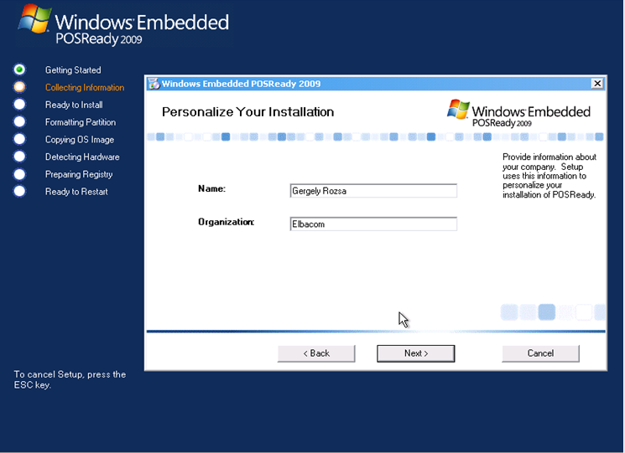
User/networking/partitioning/regional settings

Slide 23
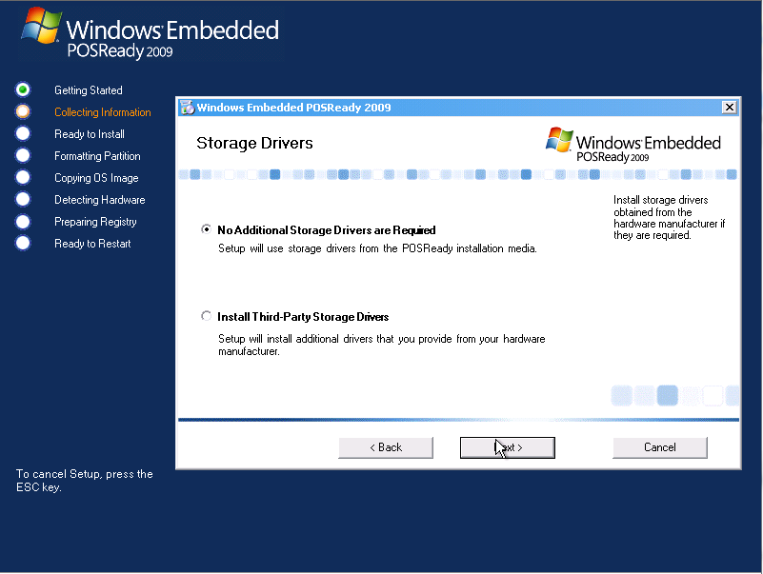
Additional drivers settings
With certain MassStorage / Raid / Sata drivers it is necessary to add...
Not only at the very beginning of the setup, pressing F6...

Slide 24
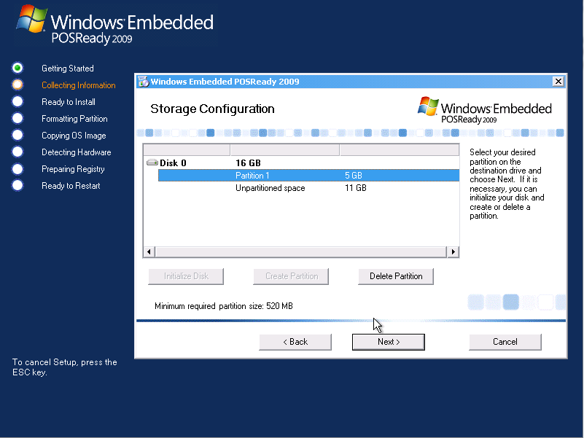
User/partition/regional settings

Slide 25
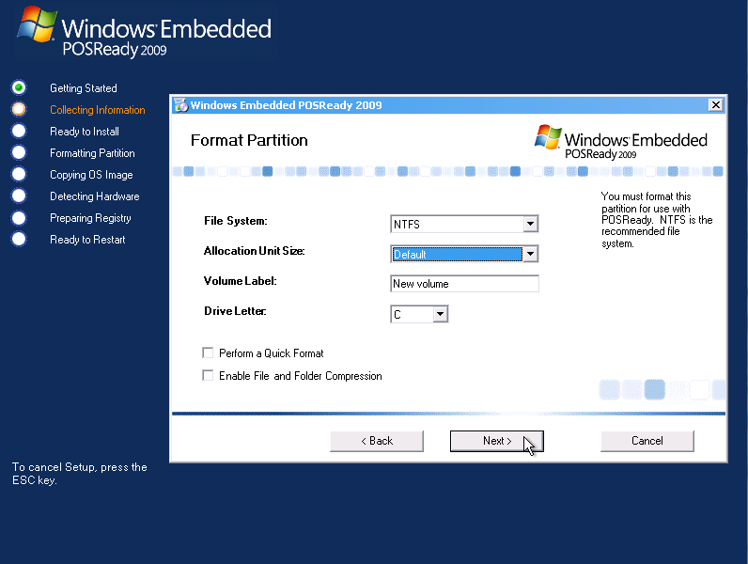
User/partition/regional settings

Slide 26
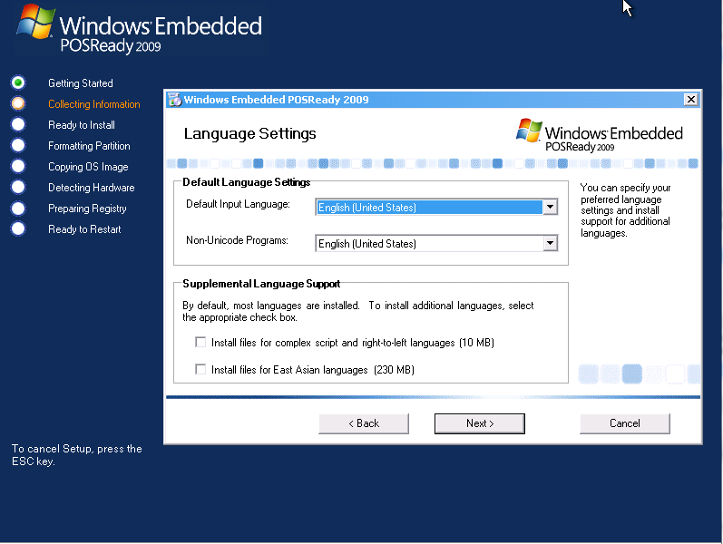
User/partition/regional settings

Slide 27
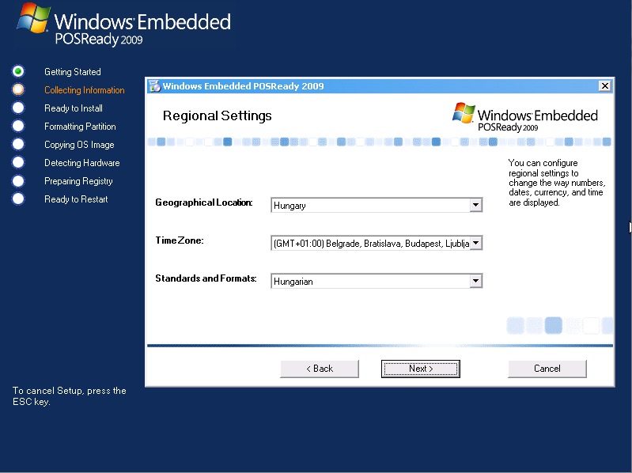
User/partition/regional settings

Slide 28
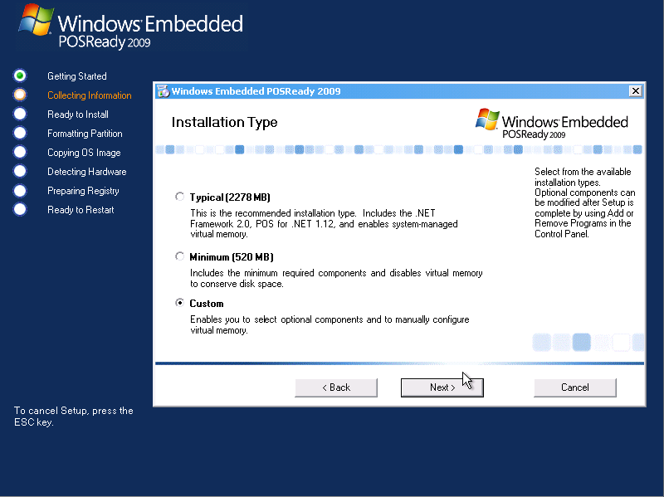
Custom installation settings

Slide 29
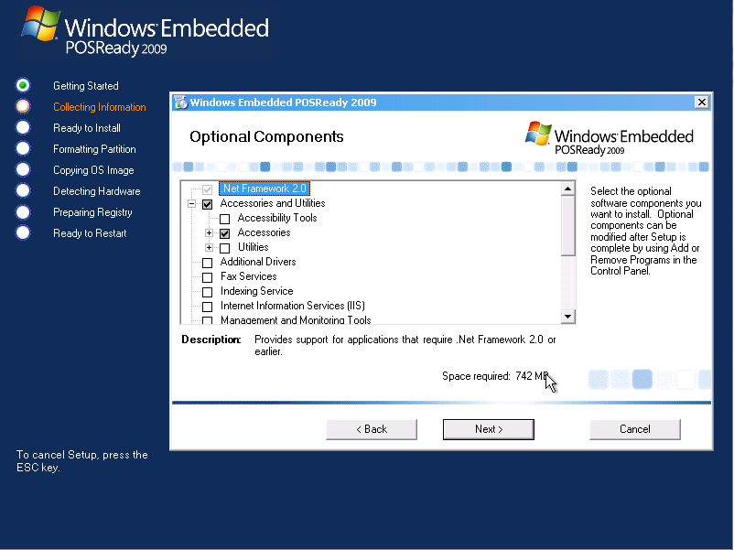
Custom installation
Additional drivers

Slide 30
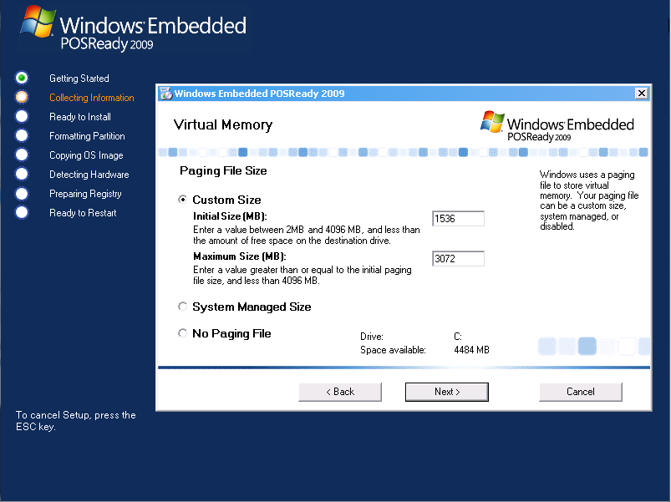
Custom installation

Slide 31

User settings

Slide 32
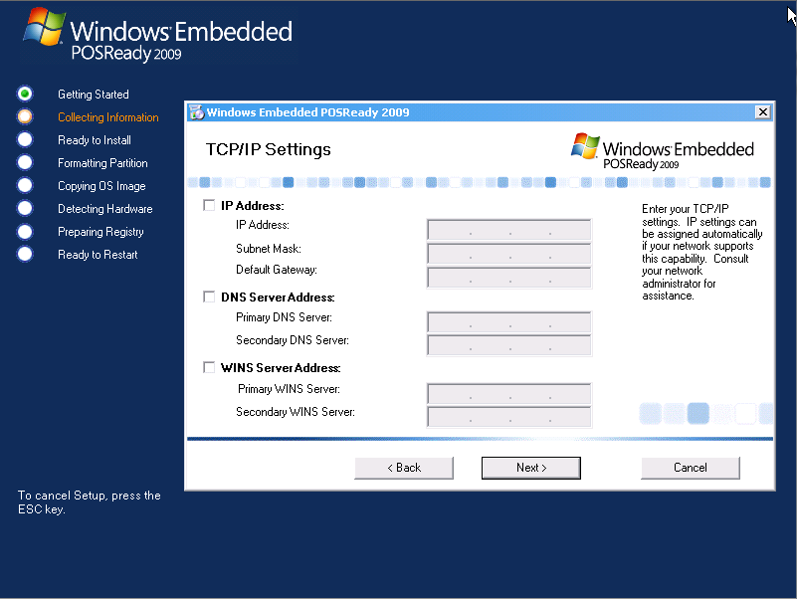
Network settings

Slide 33
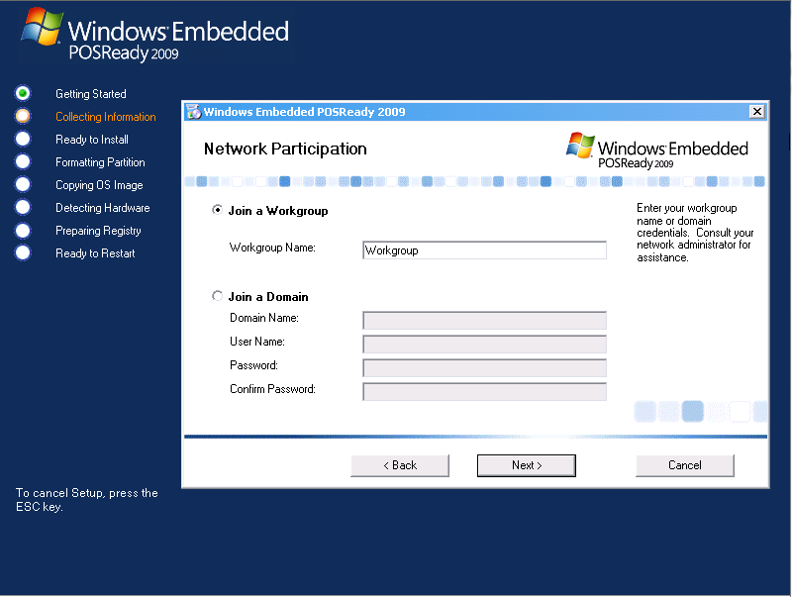
Network settings

Slide 34
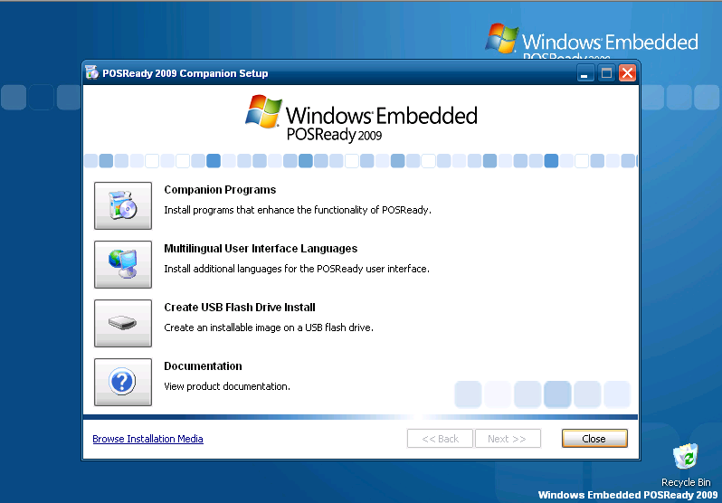
Some configuration options prior/after installation
Installation disk

Slide 35
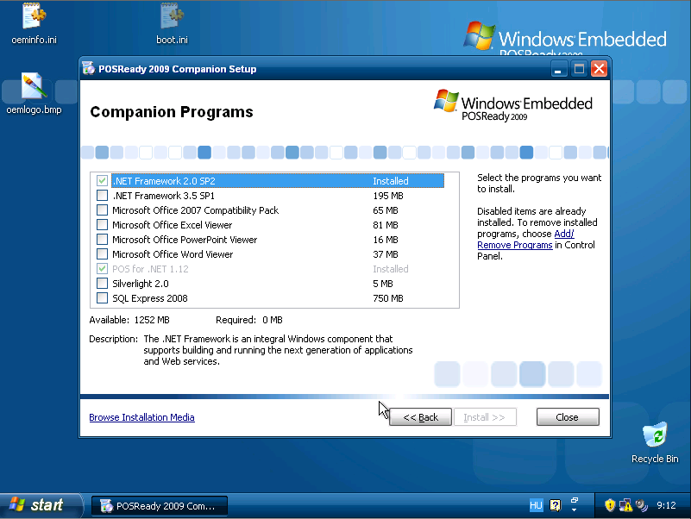
Some configuration options after installation
Add / remove companion programs

Slide 36
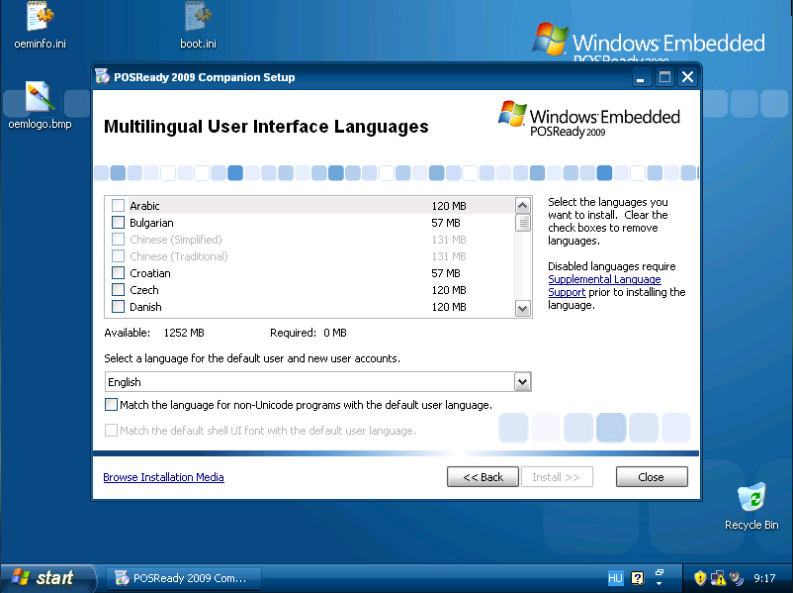
Some configuration options after installation
Add / remove language support

Slide 37
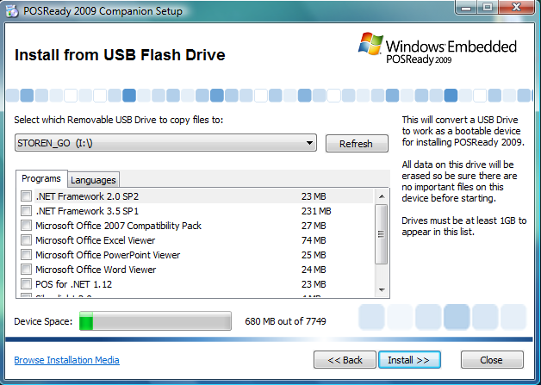
Some configuration options after installation
Create USB installation drive

Slide 38
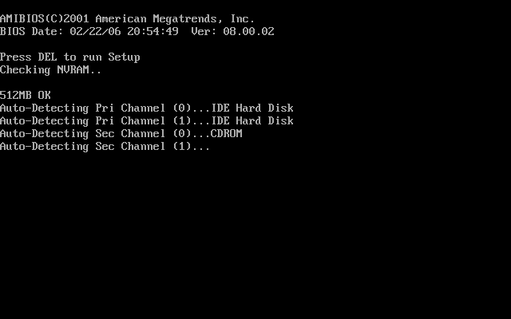
Windows Embedded POSReady 2009 DEMO
_{Embedded}
_{POSready}

Slide 39
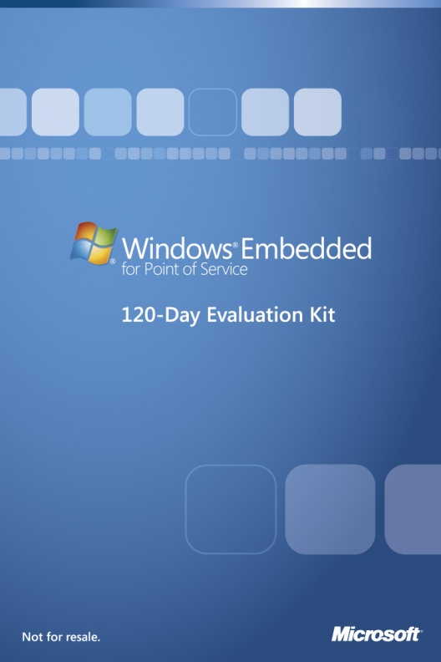
POSReady Evaluation Version
Get a free120-Day Evaluation Kit from us!
Fully functional
You can download an evaluation image with basic components with english language support only.
http://www.microsoft.com/downloads/details.aspx?displaylang=en&FamilyID=1e077ece-3f19-4c41-b219-6fcc821fb5fc

Slide 40

Features unique to Windows Embedded products
Windows Embedded POSReady 2009

Slide 41
2 types of Microsoft support
Mainstream Support
  Mainstream Support is the first phase of the product support lifecycle.
    Incident support (no-charge incident support, paid incident support, support charged on an hourly basis, support for warranty claims)
    Security update support
    The ability to request non-security hotfixes
Extended Support
  The Extended Support phase follows Mainstream Support for Business and Developer products.
    Paid support
    Security update support at no additional cost
    Non-security related hotfix support requires a separate Extended Hotfix Support Agreement to be purchased (per-fix fees also apply)

Slide 42

Availability and Support
_{Embedded}
_{POSready}
Mainstream Support
Extended Support
2024
_{Embedded}
_{for Point of Service}
Mainstream Support
Extended Support
Mainstream Support
Extended Support
^{xp} _{Professional}
_{for Embedded Devices}
2001
Mainstream Support
Extended Support
Mainstream Support
Extended Support
2002 2003 2004 2005 2006 2007 2008 2009 2010 2011 2012 2013 2014 2015 2016 2017 2018 2019 2020 2121 2022 2023

Slide 43



Product Activation
  WPA is NOT needed for POSReady and Windows Embedded Standard operating systems!!!
WEPOS / Windows POSReady 2009
Windows Embedded Standard
Windows XP Embedded
Windows XP Pro for Embedded Devices
Windows Vista Embedded

Slide 44
Embedded Enabling Features
File Based Write Filter
Registry Filter
Device Update Agent
USB 2.0 Boot
Enhanced Write Filter (only for WES and XP Embedded)

Slide 45
File Based Write Filter
Filterdriver on Filebase
Supports NTFS and FAT32
Filesystem View
Windows
Daten
Boot.ini
Debug
.log
tmp
.dat
Create
Write Filter Cache
Windows
Debug
.log
tmp
.dat
Excluded
Delete
Delete
Physical disk drive
Windows
Daten
Boot.ini
tmp
.dat
Create

Slide 46
Some configuration options after installation
Write protection
API/FBWFMGR.exe
FBWFMGR /enable
FBWFMGR /addexclusion c: \NotWriteProtectedFolder
FBWFMGR /OVERLAYDETAIL
FBWFMGR /HELP
FBWFMGR /HELP /ADDEXCLUSION
Disable command prompt:
Enable the following property in the GroupPolicyEditor to disable the Command prompt:
UserConfiguration/AdministrativeTemplates/System/”Prevent access to command prompt”

Slide 47
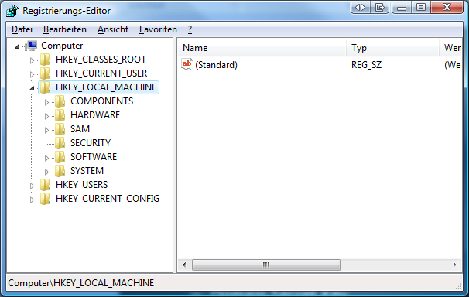
Registry Filter
FBWF works on filebase
  Registrychanges get discarded
Important Registry changes
  TSCAL Entries
  Domain Secret Key
Registry Filter writes these keys through the filter driver

Slide 48

Device Update Agent
Performs administrative tasks
  Copying files
  Editing the registry
  Run processes
Perform updates in the field
Polls automatically for updates
UPDATE

Slide 49
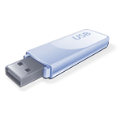
USB 2.0 Boot
Supports booting from USB 2.0 devices
Without USB 2.0 Boot BSOD 0x0000007B
  Boot Device Not Found
USB driver will be loaded earlier

Slide 50


Enhanced Write Filter (WES only)
Redirects all writes to an overlay
  Overlay can be
    Partition
    RAM
Different Modes
  Disk
  RAM
  RAM Reg
Modify
Registry
Delete Windows
Install Software

Slide 51
Enhanced Write Filter (WES only)
HORM – Hibernate Once Resume Many
  Save the hibernation point of the pc
  Always resume to the previous saved hibernation point
  Faster boot

Slide 52
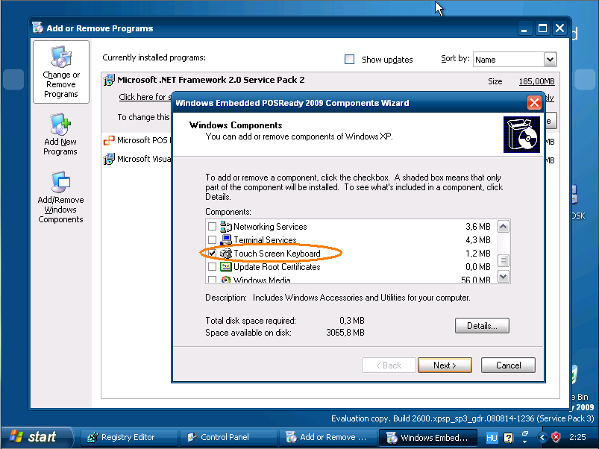
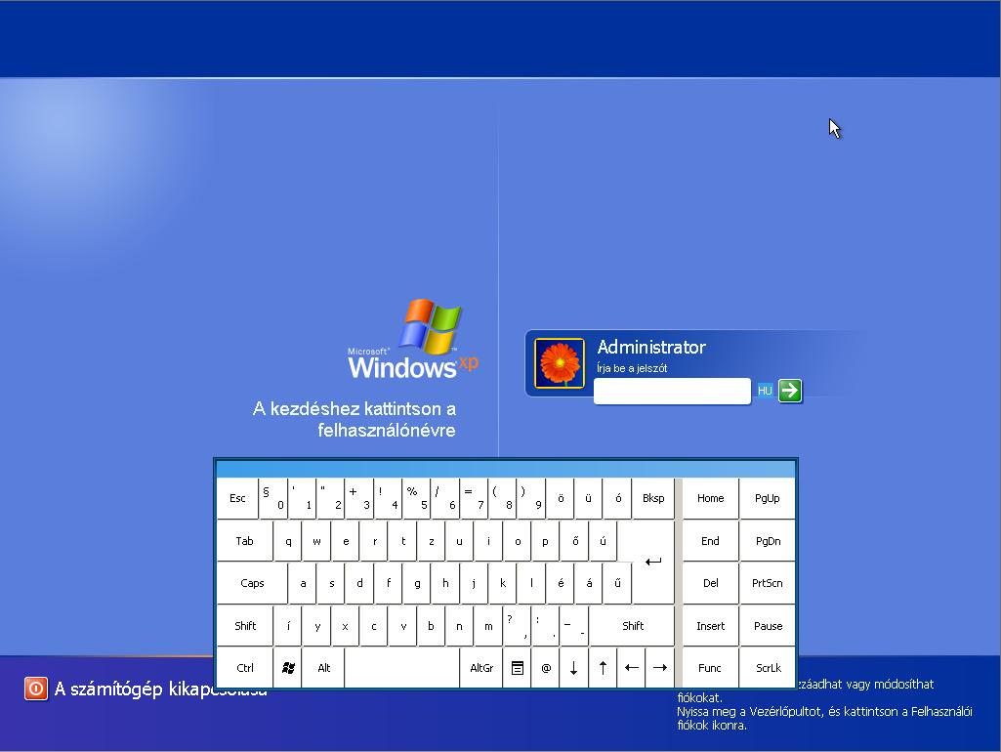
Soft keyboard
Enter credentials on devices with touch screen.
(KeyboardSurrogate.exe not supported.)

Slide 53
Some configuration options after installation
Disable CTRL+ALT+DEL
You should start the GroupPolicyEditor.
Navigate to: User configuration / Administrative Templates / System / Ctrl+Del+Options
Click and enable the „Remove Task Manager” option.
Or you can modify the Registry (This is valid for the current user only):
Create the following key:
HKEY_CURRENT_USER\Software\Microsoft\Windows\CurrentVersion\Policies\System
Add the following DWORD:
DisableTaskMgr
(Value = 1)
Disable command prompt:
Enable the following property in the GroupPolicyEditor to disable the Command prompt:
UserConfiguration/AdministrativeTemplates/System/”Prevent access to command prompt”

Slide 54
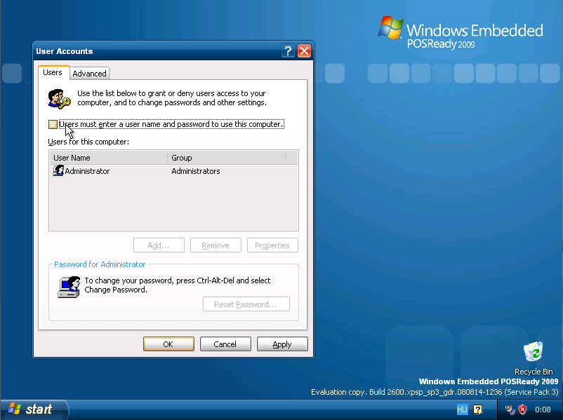
Some configuration options after installation
Disable LogOn screen
Type into the StartMenu/Run
control userpasswords2

Slide 55
Some configuration options after installation
Change bootlogo
Create a 16color(4bit) 640*480 resolution BMP image.
Copy it to the PosReady „C:\Windows” directory as „boot.bmp”.
Open the „boot.ini” in the root directory, and add the following to the end of the last line: /bootlogo /noguiboot
You should have the following in the „boot.ini” after you added the above mentioned specifiers:
multi(0)disk(0)rdisk(0)partition(2)\WINDOWS="Windows Embedded Posready 2009" /fastdetect /bootlogo /noguiboot
Reboot the computer.
Remove getting started screen
Enable the following property in the GroupPolicyEditor(gpedit.msc):
UserConfiguration/AdministrativeTemplates/System/”Don’t display Getting Started screen at logon”

Slide 56
Some configuration options after installation
Remove baloon tips
Enable the following property in the GroupPolicyEditor(gpedit.msc):
UserConfiguration/AdministrativeTemplates/StartMenuandTaskbar/”Remove Balloon Tips on Start Menu”
Disable command prompt
Enable the following property in the GroupPolicyEditor(gpedit.msc):
UserConfiguration/AdministrativeTemplates/System/”Prevent access to command prompt”
Disable status messages
Add/ modify the following value in the registry:
HKEY_LOCAL_MACHINE>Software>Microsoft>Windows>CurrentVersion>Policies>System
DisableStatusMessages (REG_DWORD)
Value =1

Slide 57
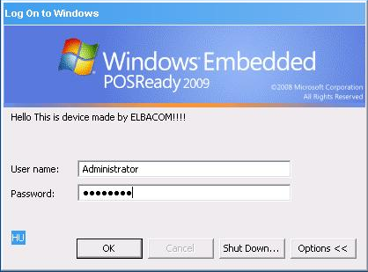
Some configuration options after installation
Modify the „Welcome message”
Add/modify the following registry entry:
  Regkey: HKEY_LOCAL_MACHINE\SOFTWARE\Microsoft\Windows NT\ CurrentVersion\Winlogon
  Data Type: REG_SZ [String Value]
  Value Name: LogonPrompt
  Value Data: [Enter the text of the message]

Slide 58
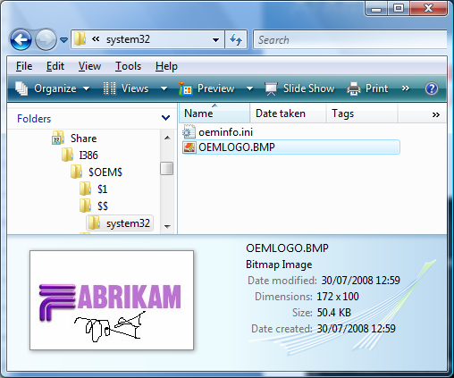
Add the OEM information
Create a file oeminfo.ini in c:\windows\system32 folder.
Oeminfo.ini
[Version]
Microsoft Windows XP and the Windows .NET Server family
WinVer=5.01
[General]
Manufacturer=Fabricam
Model=DEMOPC
[Support Information]
Line1="Call +44-118-909-2480"

Slide 59
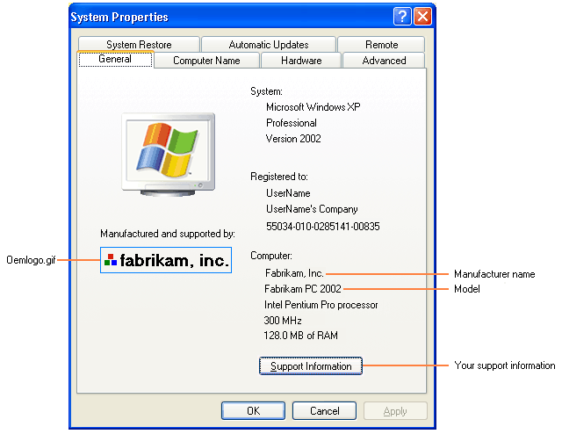
Add OEM Logo and details
Create a bitmap file, Oemlogo.bmp, that contains your company logo. The bitmap must be 172 x 100 pixels in size. Place the file in the \Windows\System32\ folder.

Slide 60
Other way to do customization...
Hundreds of settings are available in the group policy editor. Spend some time to study the available settings.
Use XP tweaker utilities, to simplify the customization process...
For example:
It is easier to hide the mouse cursor using the TWEAK UI 2.1, than to change the settings directly in the registry.

Slide 61
Clone the ready made images
To copy the operating system to more target devices.
    After all customizations are done (operation system settings and applications are running fine)
Use Sysprep to avoid collisions among cloned images
Clone the image by using the free tool Microsoft Imagex. (Or Norton Ghost, etc...)
At least HAL should remain the same...

Slide 62
SYSPREP
Use Sysprep to avoid collisions among cloned images.
Examples: SID, computer name, fixed IP, other network settings, etc...
Step1: Copy the complete SYSPREP directory from the installation disc(utilities directory) to the C: drive of your device.
Step2: Start the SYSPREP.EXE
Step3: Select the minisetup on the GUI windows of the SYSPREP application, if you want minisetup.
Step4: Select reseal to reseal the image. The SYSPREP starts now to remove all the settings, which can cause conflict among the cloned images. Restarts the device....
Step5: Before the device restarts, you have to capture the image.
Step6: Copy the image to the target device. It starts to boot, SYSPREP generates unique SID, and starts minisetup or the normal setup screen.

Slide 63
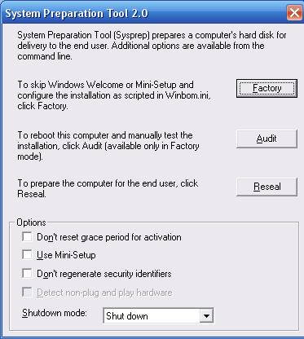
System preparation tool
Reseal Mode removes the Product Key used in installation, resets the EULA and prepares the machine for shipment
SYSPREP.INF
fbreseal [-autologon | -keepall | -keepdomain | -keepmounted | -keepnet | -keepuser]

Slide 64
SYSPREP
Sysprep is able to change the PID, but this feature is not reliable, and so NOT supported!!!
The ONLY way to change from Evaluation version to full licensed version is to reinstall the image with the full version PID.

Slide 65
Clone the image with IMAGEX
Capture image:
Imagex.exe /compress fast /capture c: z:\myimage.wim „my Windows Install” /verify
Restore image:
Imagex.exe /apply c:\myimage.wim 1 c:
Or just copy/paste the complete partition/s of your preinstalled device to the target device.

Slide 66
Remote connectivity and remote management
RDP
TS and Vista features
Windows Update
Systems Management Server (System Center Configuration Manager)
System Center Operations Manager
It is important to keep your system up to date.
Windows Update or Windows Server Update Services
http://go.microsoft.com/fwlink/?LinkId=129944
http://technet.microsoft.com/en-us/wsus/default.aspx

Slide 67
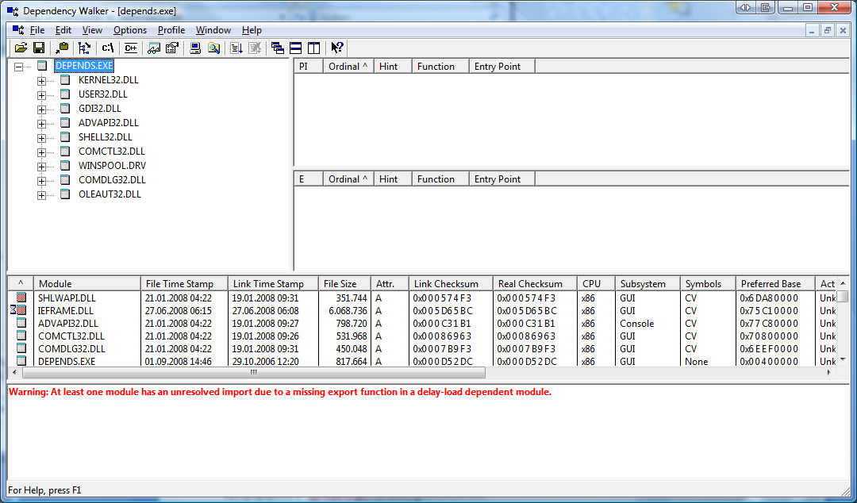
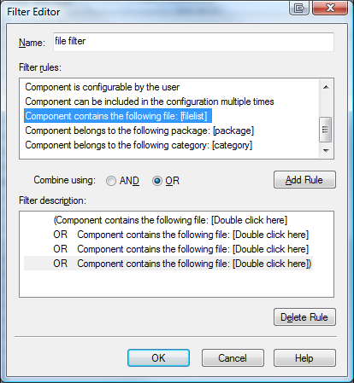
Dependency Walker
Lists all dependencies
of an executable
Create a filter in
Target Designer to
search for the needed
files
http://www.dependencywalker.com

Slide 68

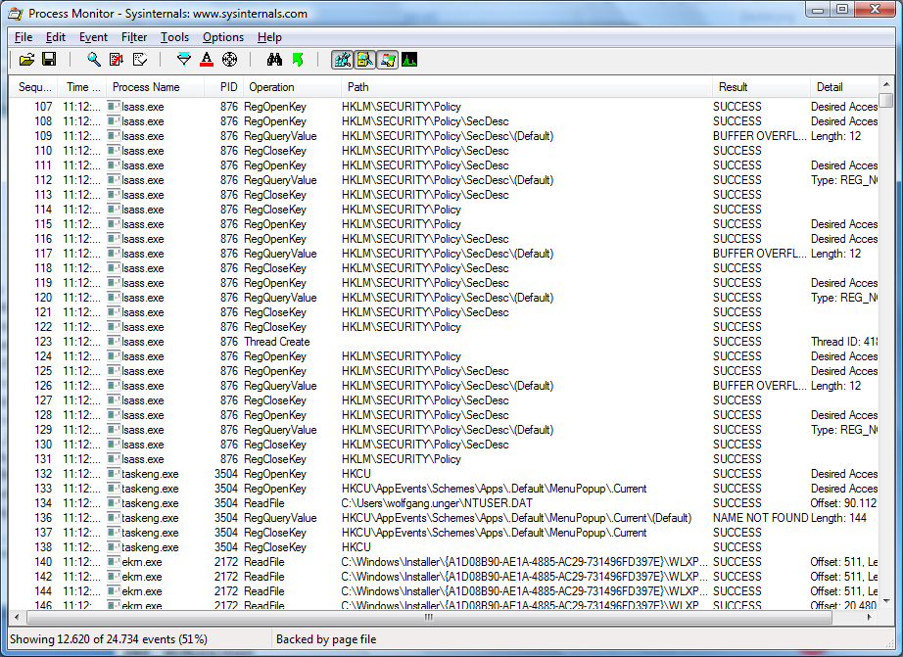
Tools
  Process Monitor *
  Filemon
  Regmon
Windows
Sysinternals
http://www.sysinternals.com
*) Process Monitor won‘t run on XPe – use Filemon and Regmon instead

Slide 69
WinPE20
Get the Windows AIK Vista OPK here:
https://oem.microsoft.com/script/contentpage.aspx?PageID=561189
After installing it open the “Windows PE Tools Command Prompt”
Type copype x86 c:\winpe-x86 to create a WinPE x86 working directory.
Go to the directory c:\winpe-x86 and type:
mkdir working
imagex /apply winpe.wim 1 working
Copy Imagex and bootsect.exe to the image:
mkdir c:\winpe-x86\working\tools
xcopy “c:\Program Files\Windows OPK\Tools\x86\*.*”
c:\winpe-x86\working\tools /cherky
copy “c:\Program Files\Windows OPK\Tools\PETools\x86\BootSect.exe”
c:\winpe-x86\working\tools
Add drivers (LAN or storage) using peimg /inf
Capture the new image:
imagex /boot /compress max /capture c:\winpe-x86\working c:\winpe-x86 \
boot.wim “WinPE x86”
WinRE
http://technet.microsoft.com/en-us/library/cc749147(WS.10).aspx

Slide 70
Clone the image by using remote deployment
WDS and RIS is also available. (Windows Server technologies.)
Pre-Boot Execution Environment (PXE) compatible network adapter needed.
RIS:
RIStndrd.sif or RIPrep.sif is not used → unattended.xml
  \I386 folder
  \Setup folder
  Win51
  Win51is
  Win51.pos
  Winbom.ini
For other steps please read the following webpage:
http://msdn.microsoft.com/en-us/library/dd458824(WinEmbedded.20).aspx

Slide 71
Clone the image by using remote deployment
Windows Deployement Services (WDS) native mode:
Please make a backup copy before using SYSPREP!
Reseal the image with sysprep.
After restart capture a .WIM format file
(using a RAM boot image http://technet.microsoft.com/en-us/library/cc709665(WS.10).aspx )
Add the image to your WDS server.
Additional drivers:
.sys files to the \I386 and \I386\system32\drivers folders
.inf files to the \I386 and \I386\inf folder
All other files to the \I386\system32 folder

Slide 72
Custom scripts
PreSetup.cmd
net use * \\mysharedlocation /user:username password >> X:\output.log
PostSetup.cmd
copy X:\output.log C:\output.log
Change LOG location by using the SetupLauncher
The /logging switch enables you to change the name and location of the installation log. By default, the installation log is stored in the \Windows directory of the destination disk.
Setup.exe /logging:A:\POSReadyInstall.log
Unattended.XML
http://msdn.microsoft.com/en-us/library/dd458835(WinEmbedded.20).aspx

Slide 73
Security templates
XP Pro like security templates are used. To enable the MMC snap-in follow the next steps:
Click Start, and then click Run.
Type mmc and then click OK.
On the File menu in the Microsoft Management Console, click Add/Remove Snap-in.
Click Add.
In the Available Stand Alone Snap-ins list, click Security Configuration and Analysis.
Click Add, click Close, and then click OK.
In the left pane, click Security Configuration and Analysis, and view the instructions in the right pane.
Right-click Security Configuration and Analysis, and then click Open Database.
In the File Name box, type the name of the database file, and then click Open.
Choose the security template that you want to use, and then click Open to import the entries that are contained in the template to the database.
Right-click Security Configuration and Analysis in the left pane, and then click Configure Computer Now.

Slide 74
Autostart applications
3 ways for realizing autostart:
Starting an application at startup by using a Startup folder item
Starting an application at startup by using the Run key in the system registry
HKEY_CURRENT_USER\Software\Microsoft\Windows\CurrentVersion\Run
(HKLM and RunOnce)
Starting an application as the Windows shell
[HKEY_LOCAL_MACHINE\SOFTWARE\Microsoft\Windows NT\CurrentVersion\Winlogon] "Shell"="yourapp.exe"

Slide 75
Resources
http://www.posready.com
http://blogs.msdn.com/pointofservice/
http://msdn.microsoft.com/en-us/library/bb848017.aspx
http://www.nrf-arts.org/
Hungarian WAIK:
http://www.microsoft.com/downloads/details.aspx?FamilyId=94BB6E34-D890-4932-81A5-5B50C657DE08&displaylang=hu

Slide 76
Who's who?
Compact
POSready
Notes:
A brand name for Microsoft‘s embedded technologies & tools

Slide 77
POSReady vs. WES
Category | POSReady 2009 | Windows Embedded Standard
Footprint | Minimum RAM: 64 MB Minimum Hard-disk space: 512 MB for core image | 12,000 Individual Components; 40 MB at smallest
Processor | x86 | x86
Win32 Applications and Drivers | Full Win32 compatibility | Full Win32 compatibility
Support life cycle (10 years) | Mainstream support ends April 2014. Extended support ends April 2019. | Mainstream support ends April 2014. Extended support ends April 2019.
Ready to Install OS | Yes | No.
Windows Update Services | Yes. | Available on local WSUS.
POS for .NET to interface with peripherals following UPOS standard | Supported | Not Supported
Add/Remove Windows Components | Yes | Depends on configuration
Language Collections | Yes | No
MUI | Add-on | Must be built into the image
Componentized Drivers | Not required, can use XP Pro drivers | Yes
Enhanced Write Filter | No | Yes
El-Torito Emulation Specification – supports running the OS from a CD | No | Yes
USB Boot | Yes | Yes
.NET Framework 3.5 Support | Yes | Yes
Silverlight Support | Version 2.0 | Version 1.0
Japanese Font Set | Yes | Yes
SCCM Client Support | Yes | Yes
SCOM Client Support | Yes | Yes
SCCM OSD Support | Yes | Yes

