Slide 1

Solution Embedded Products
Microsoft Embedded Channel
Windows XP Pro for Embedded Devices
Windows Vista Embedded
WEPOS / Windows POSReady
Windows Embedded Standard
Windows XP Embedded

Slide 2
XP Embedded – Tools Installation
Installation Procedure
  Disc 1 (X10-50442)
    Install Tools
    Install Microsoft SQL Desktop Edition
    Install Component Database
  Disc 2 (X10-50443)
    Contains Component Database
  Disc 3 (X10-50444)
    Upgrade Database to SP2
    Upgrade Tools to SP2
  FP2007 Installation (X13-14119)
    Upgrade Database to FP2007
    Upgrade Tools to FP2007
  Update Rollup 1.0 (X13-82297)
    Import Components to Database
  Service Pack 3 (Xxx-xxxxx)
    Import Components to Database

Slide 3
Solution Embedded Products
Microsoft Embedded Channel
Windows XP Pro for Embedded Devices
Windows Vista Embedded
Windows Embedded POSReady
Windows Embedded Standard

Slide 4
What is Windows Embedded Standard
Componentized Version of Windows XP Professional
  Fully compatible to full version of XP Professional
  Contains all functions of XP Professional
    + additional Embedded Features
Allows to create a fully customized Windows
  Which contains only the functions you need
  smaller footprint
No Windows Product Activation
  Create one master image
  Clone it as often as you need it
  License the image with the license sticker

Slide 5
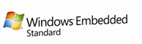
Windows Embedded Standard
Based on Windows XP Embedded technology
Easier Setup
  Single Setup DVD
  One installs all
Tools equal to XP Embedded
  Target Designer
  Component Designer
Configuration files are compatible
  You can import XPe slx files to
  WES Target Designer
5
4
3
2
1
Cost
Flexibility
Knowledge

Slide 6


New Features in
Windows Embedded Standard
Microsoft Silverlight
.NET Framework 3.5
RDP 6.1
Network Access Protection
Sysprep
SCCM Operating System Deployment (OSD)

Slide 7
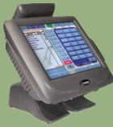



How to build an Image
Transfer the Image
Get Softwaredependencies
Get Hardwareinformation
Build the Image

Slide 8
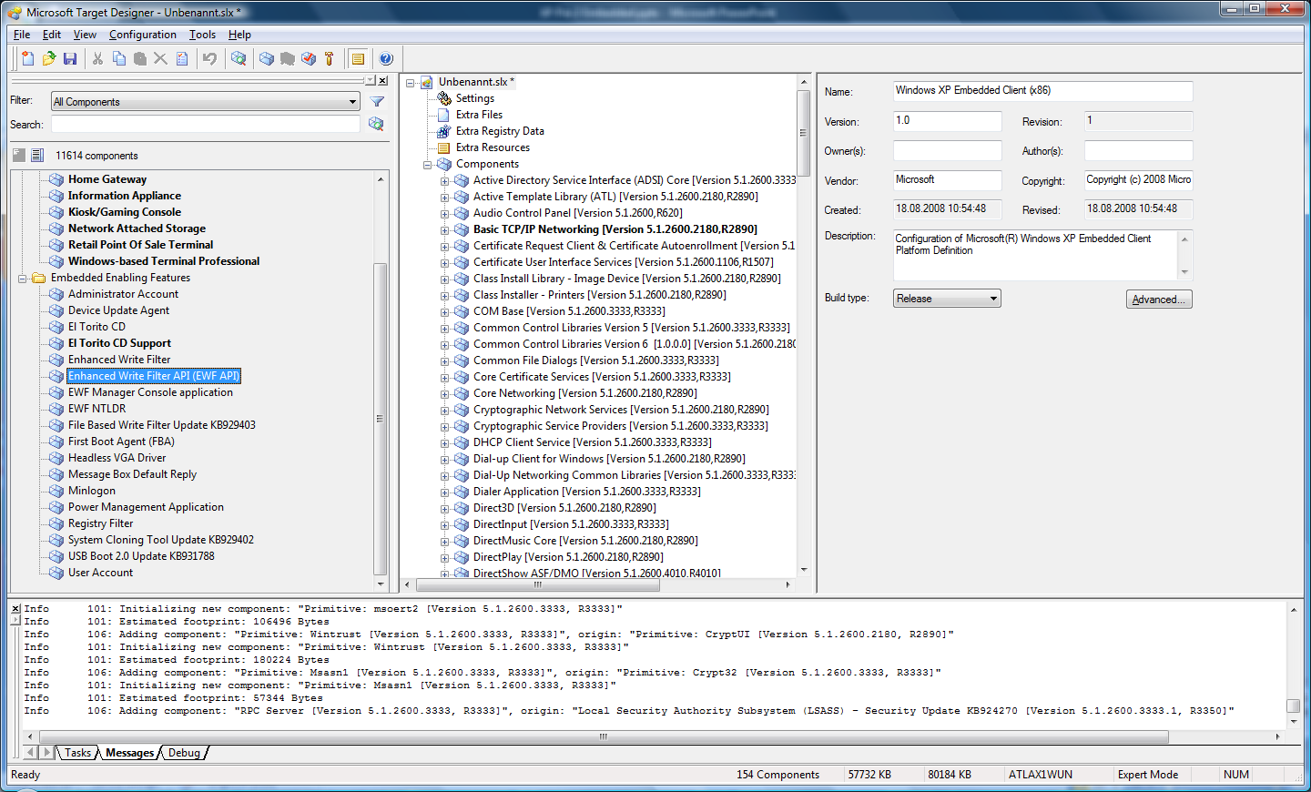
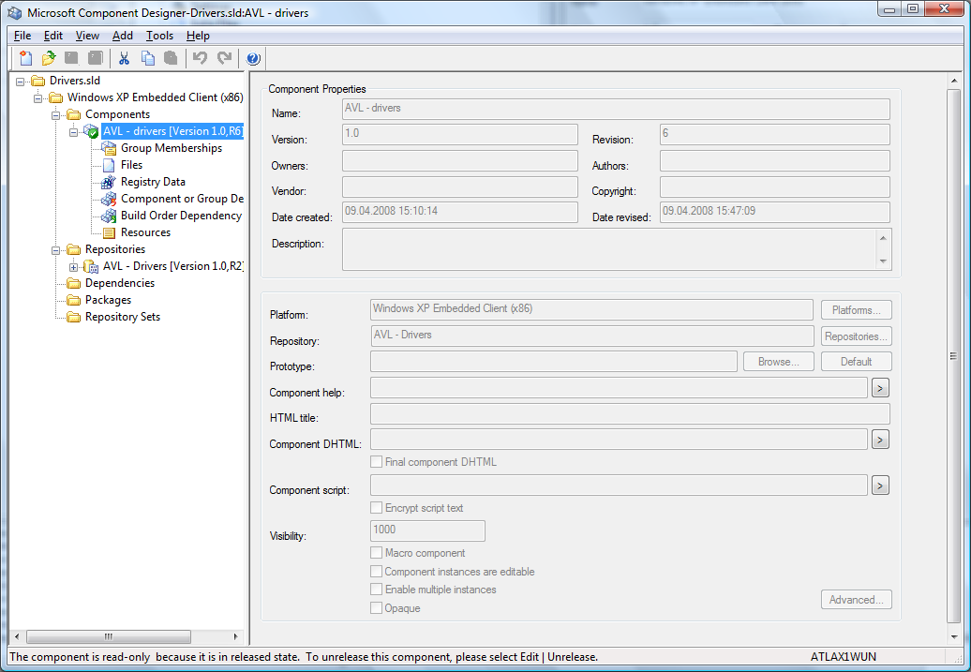
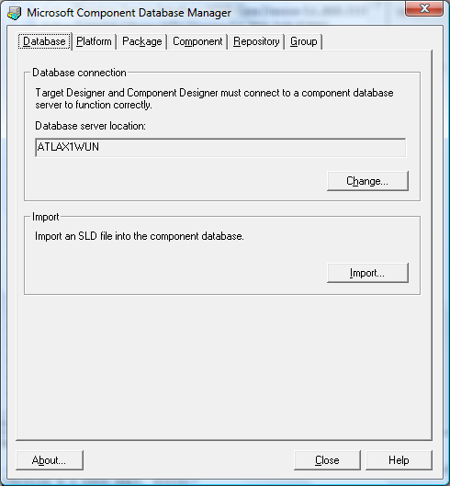
Windows Embedded Studio
Target Designer
Component Designer
Database Manager
Target Analyzer
TAP.EXE

Slide 9
Windows Embedded Studio
Target Designer
  Tool to build your
  XP Embedded / WES Image
  Add the needed components to your configuration
  Dependency Check
  Build the Image

Slide 10
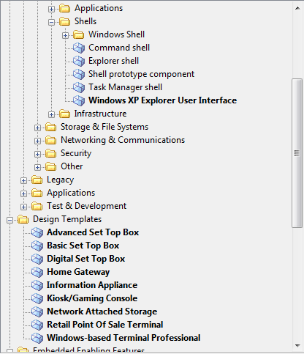
Target Designer
Componentlist
Contains all available comoponents in the component database
Bold Items
  Marco Components

Slide 11
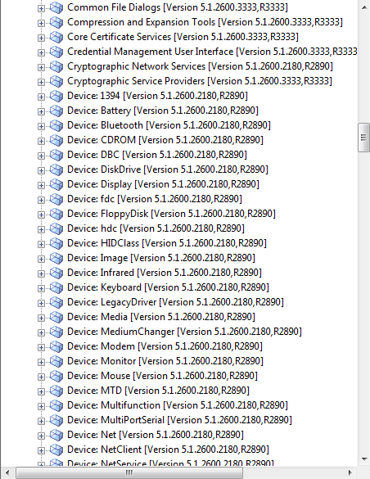
Target Designer
Components in the image
Displays all components added to the image
Some components have additional settings

Slide 12
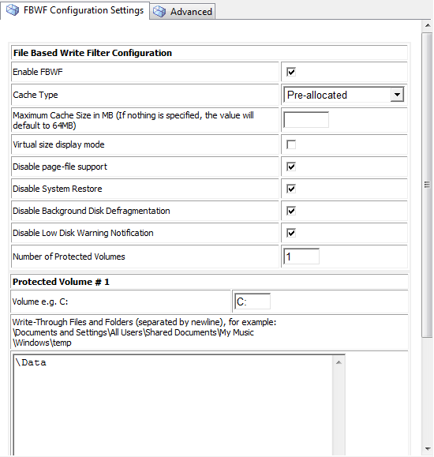
Target Designer
Componentsettings

Slide 13
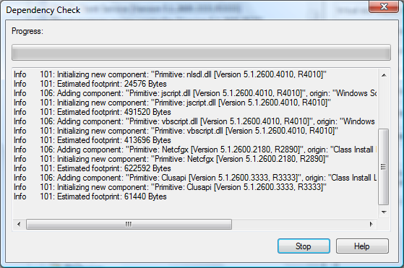
Target Designer
Dependency Check
  Checks for missing dependencies
  Automatically add missing components
  Removes unneeded components

Slide 14
Windows Embedded Studio
Target Designer
Component Designer
Database Manager
Target Analyzer
TAP.EXE

Slide 15
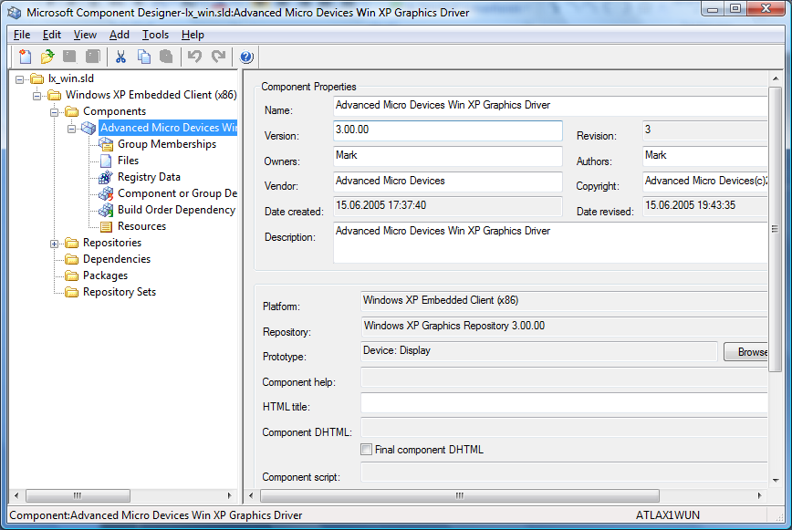
Component Designer
Create components
  Drivers
  Applications
  Macrocomponents
Import
  INF Files
  PMQ Files
  (TAP Output)

Slide 16
Component Designer
Importing Drivers
  Import INF File
  Specify the repository
  (where the files are located)
  Save the component
  Import the new sld file into the database

Slide 17
Windows Embedded Studio
Target Designer
Component Designer
Database Manager
Target Analyzer
TAP.EXE

Slide 18
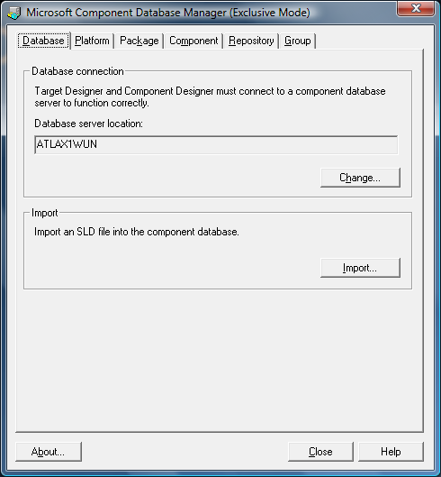
Component Database Manager
Used to
  Change the component database location
  Import components
  View installed components
  Delete components

Slide 19
How to build an Image
Transfer the Image
Get Softwaredependencies
Get Hardwareinformation
Build the Image

Slide 20
Windows Embedded Studio
Target Designer
Component Designer
Database Manager
Target Analyzer
TAP.EXE

Slide 21
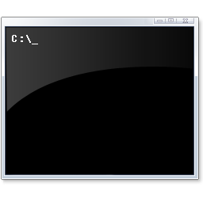
Target Analyzer Probe
TA.EXE – 16 Bit Version
  Runs under DOS
  Enumerates only devices recognized by BIOS
TAP.EXE – 32 Bit Version
  Runs under Windows (Windows XP, Windows PE)
  Enumerates all devices recognized by Windows
    Gets devices from registry

Slide 22
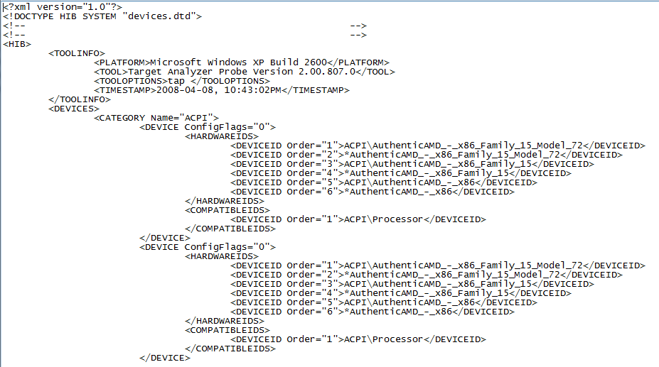
Target Analyzer Probe
Creates an output file → devices.pmq
  XML file
Contains HW-Ids of devices
File can be imported to
  Target Designer
  Component Designer

Slide 23
How to build an Image
Transfer the Image
Get Softwaredependencies
Get Hardwareinformation
Build the Image

Slide 24
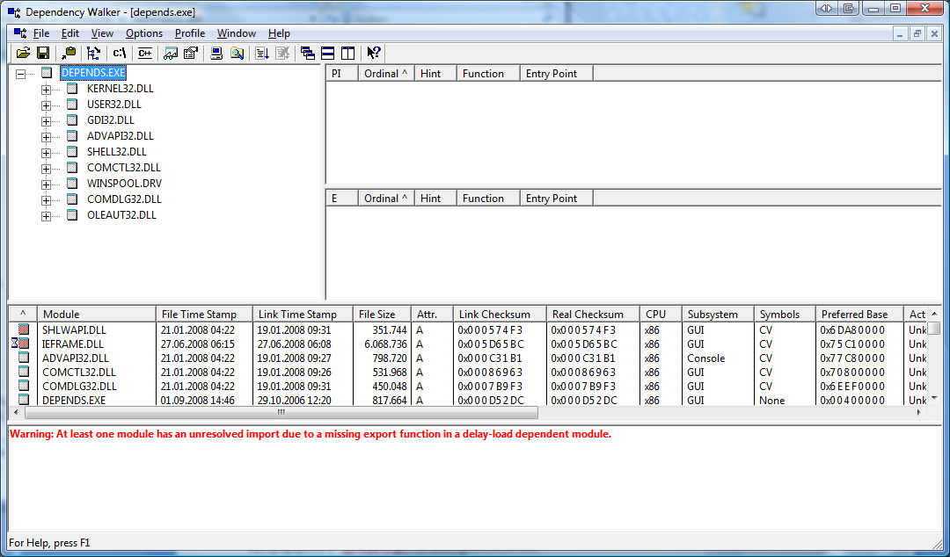
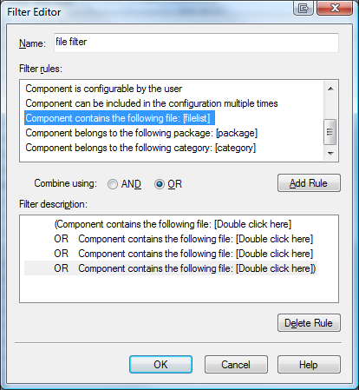
Dependency Walker
Lists all dependencies
of an executable
Create a filter in
Target Designer to
search for the needed
files
http://www.dependencywalker.com

Slide 25

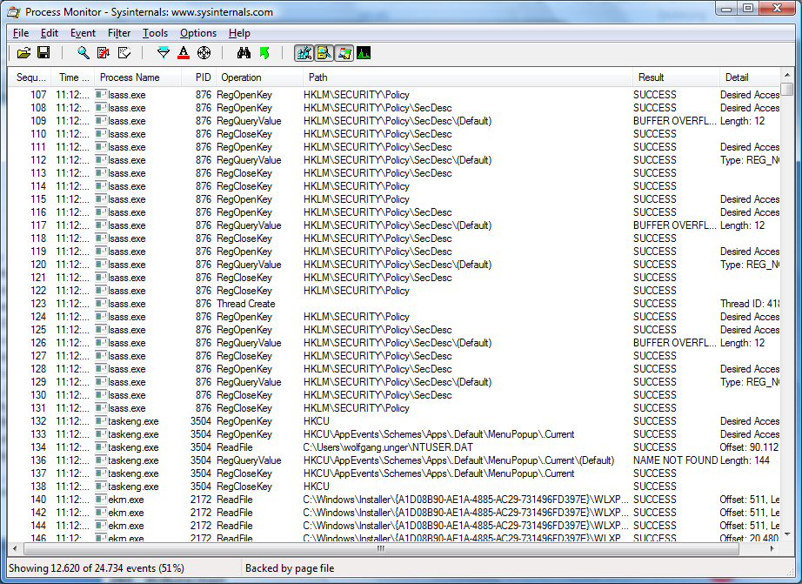
Tools
  Process Monitor *
  Filemon
  Regmon
Windows
Sysinternals
http://www.sysinternals.com
*) Process Monitor won‘t run on XPe – use Filemon and Regmon instead

Slide 26
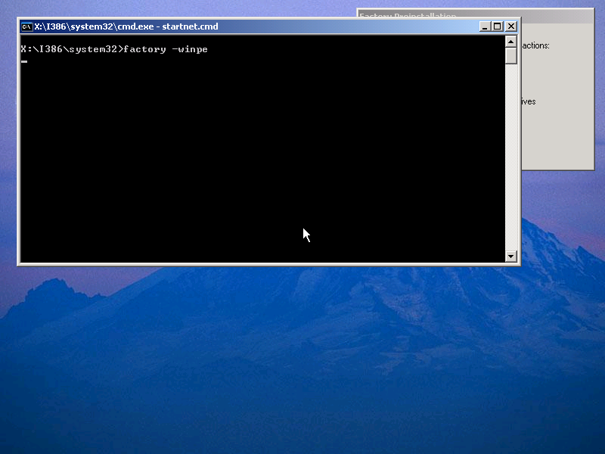
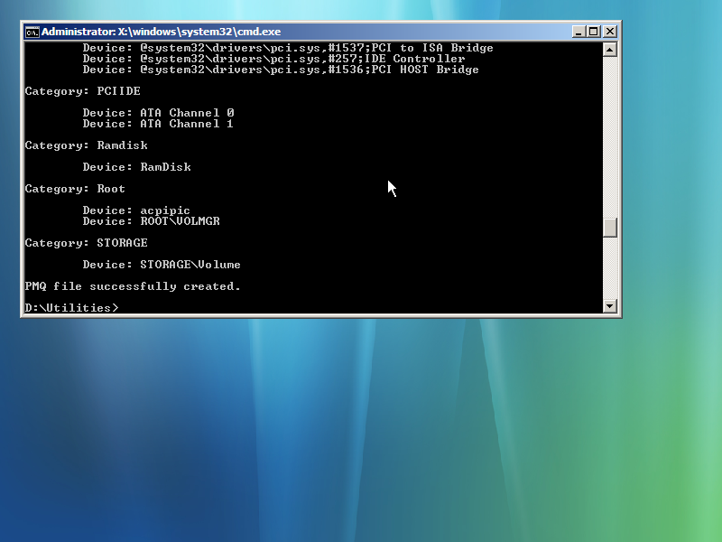
Gathering Hardware Information
Boot Windows Embedded Standard Setup DVD
Connect an USB drive to the system or map a network drive
Change to the writable drive
Run TAP
  Creates devices.pmq

Slide 27
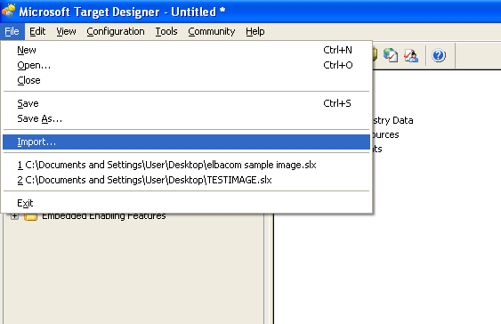
Importing the Hardwareinformation
Click File – Import
Select devices.pmq
Click Start
Target Designer will
search for the devices in the Database

Slide 28
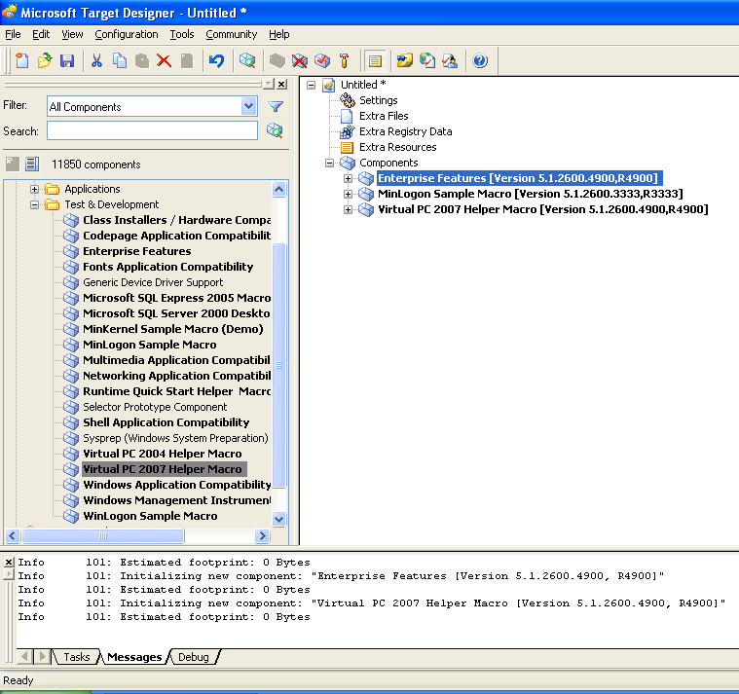
Adding components
Add Components
  Enterprise Features
  Minlogon Sample Macro
Running Dependency Check

Slide 29
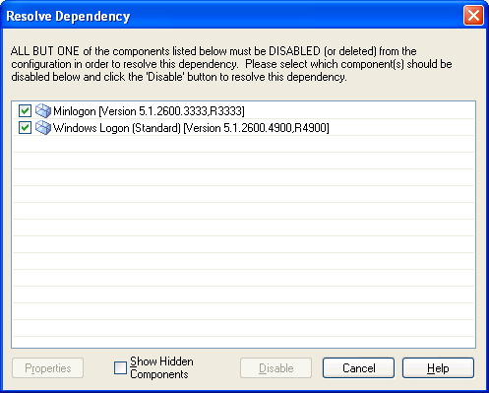
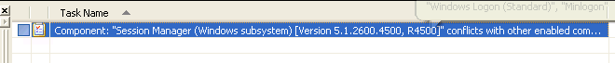
Adding components
Tasks
  Conflict
  Multiple Choice

Slide 30
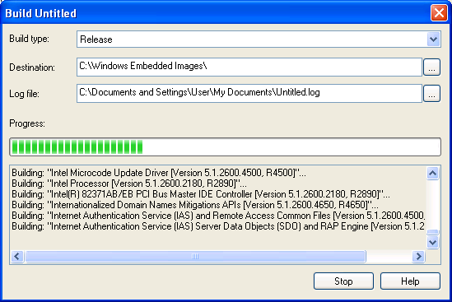
Building the image
Building the image
  Creates directory structure
  in the given output directory

Slide 31
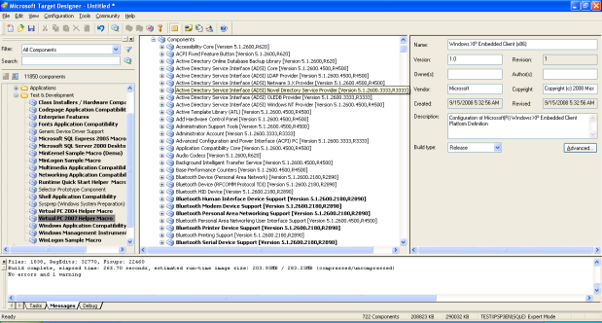
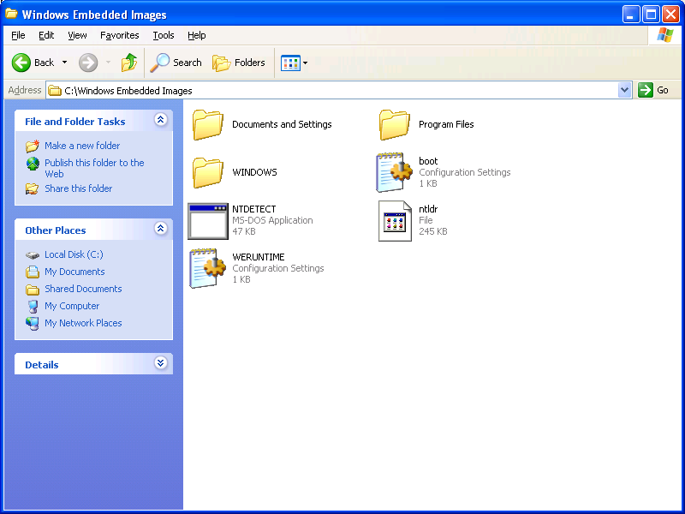
Transfering the image
Booting Windows PE
Running diskpart
preparing the target disk
Formatting the target disk
Mapping Networt Drive
Copying the Image to the target disk drive
Rebooting

Slide 32
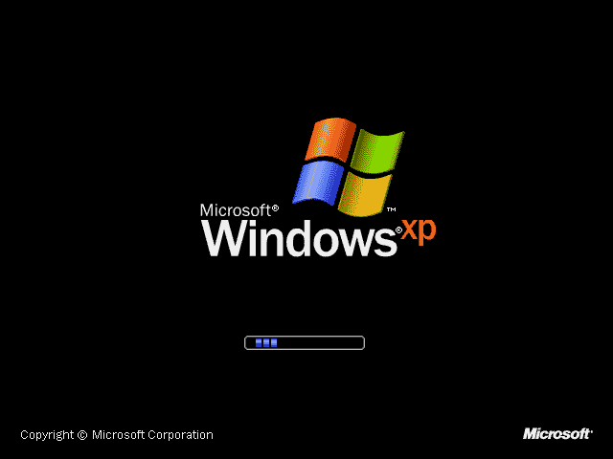
Windows Embedded Standard Boot
Boots into First Boot Agent

Slide 33
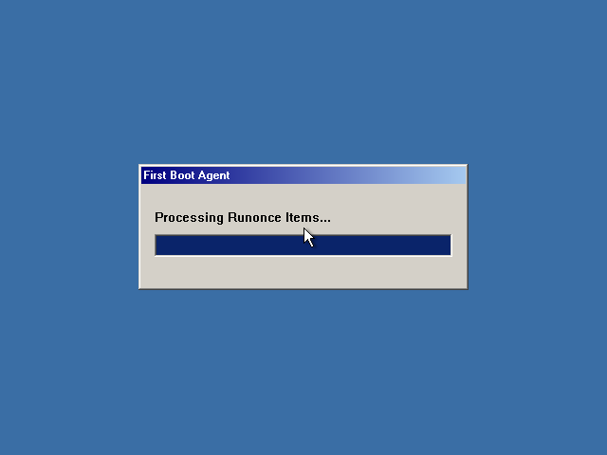
First Boot Agent
Initial configuration of the image
creates user accounts
installs PnP devices
component / file registration
installation of applications (RunOnce, .NET 2.0)

Slide 34
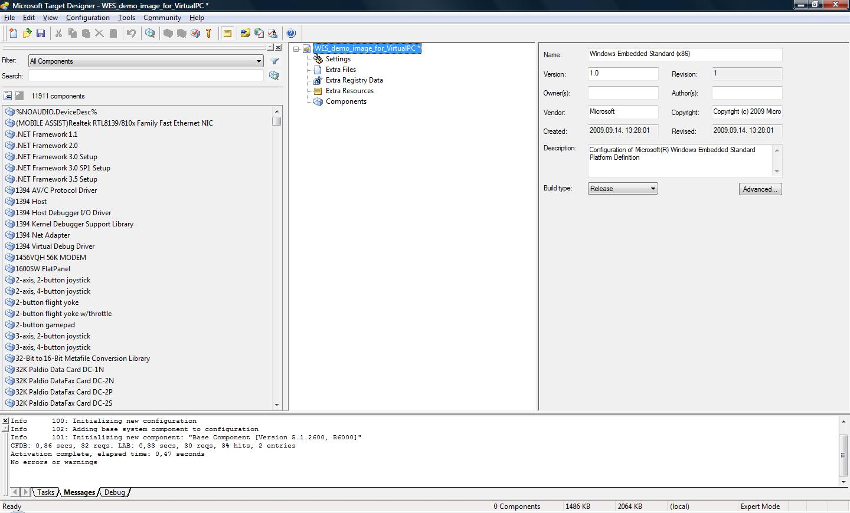
Windows Embedded Standard Target Designer DEMO screenshot

Slide 35
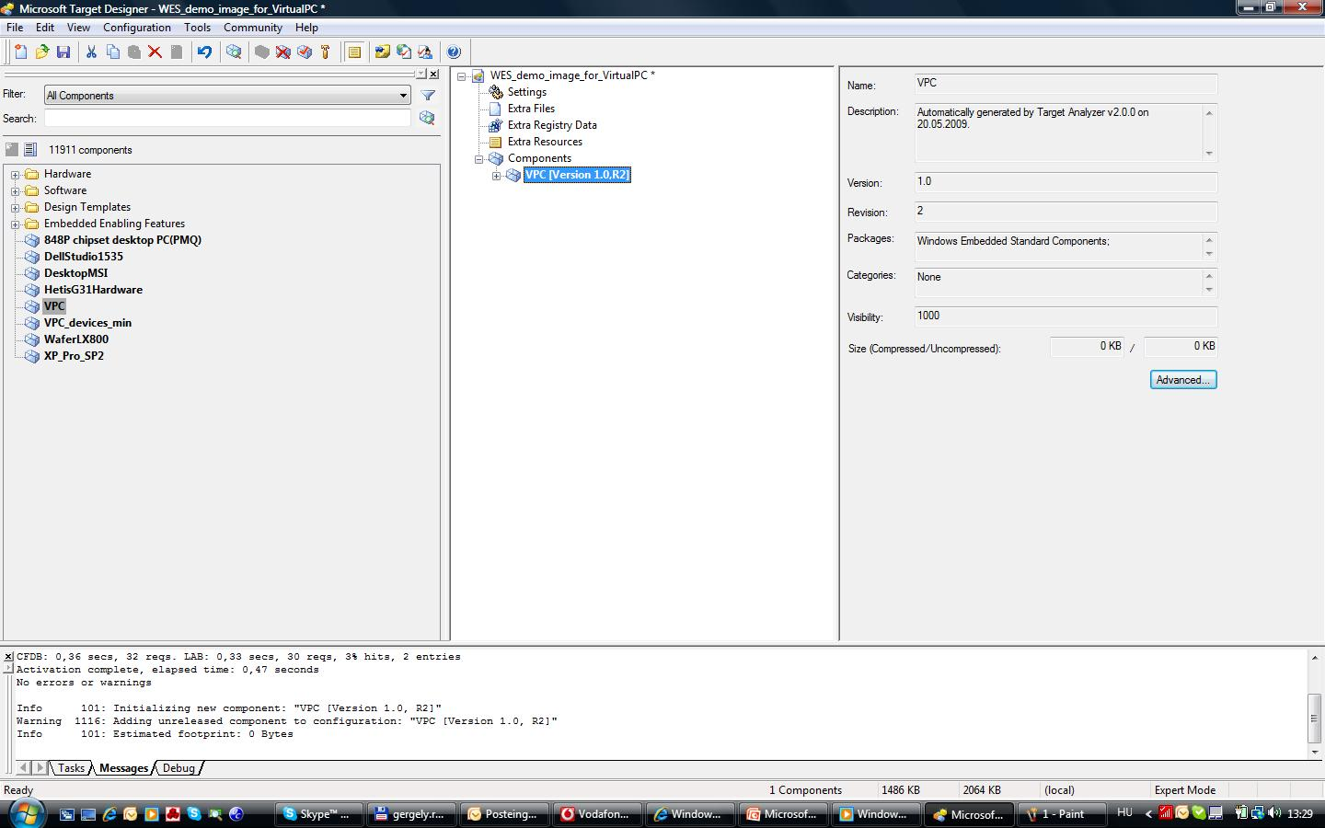
Windows Embedded Standard Target Designer DEMO screenshot

Slide 36
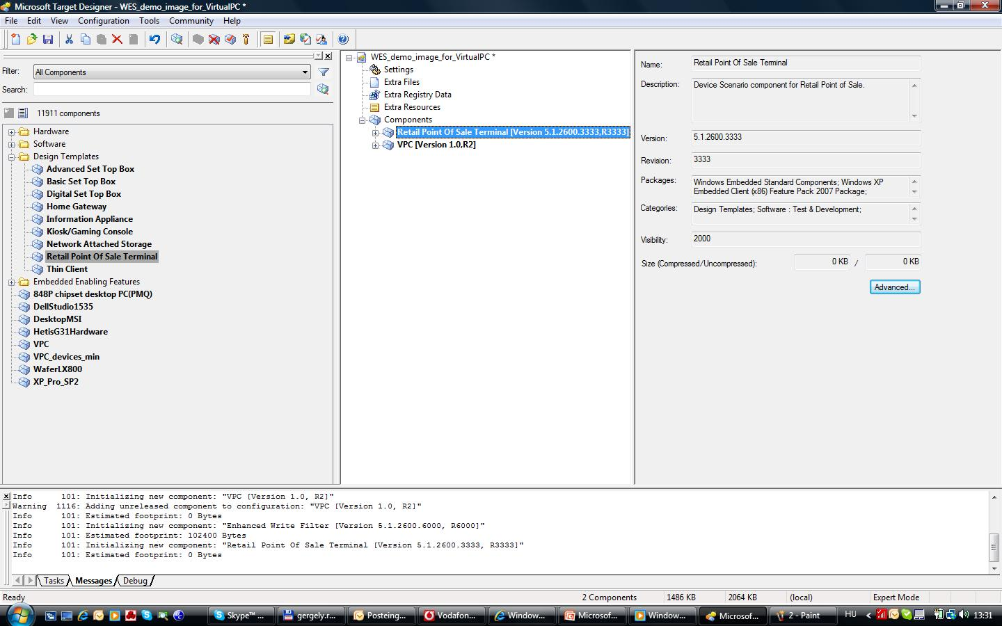
Windows Embedded Standard Target Designer DEMO screenshot

Slide 37
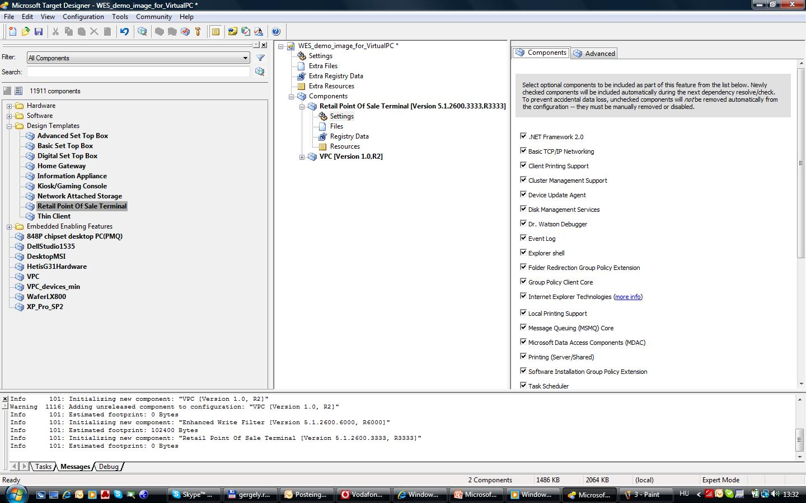
Windows Embedded Standard Target Designer DEMO screenshot

Slide 38
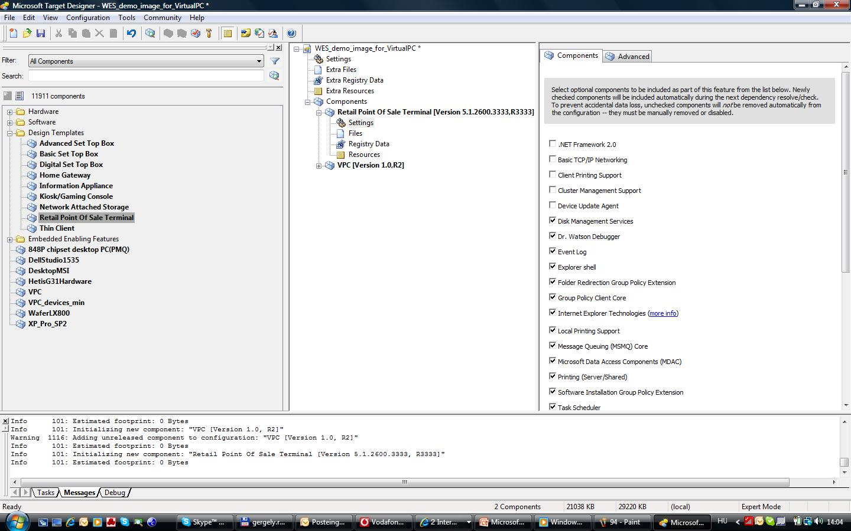
Windows Embedded Standard Target Designer DEMO screenshot

Slide 39
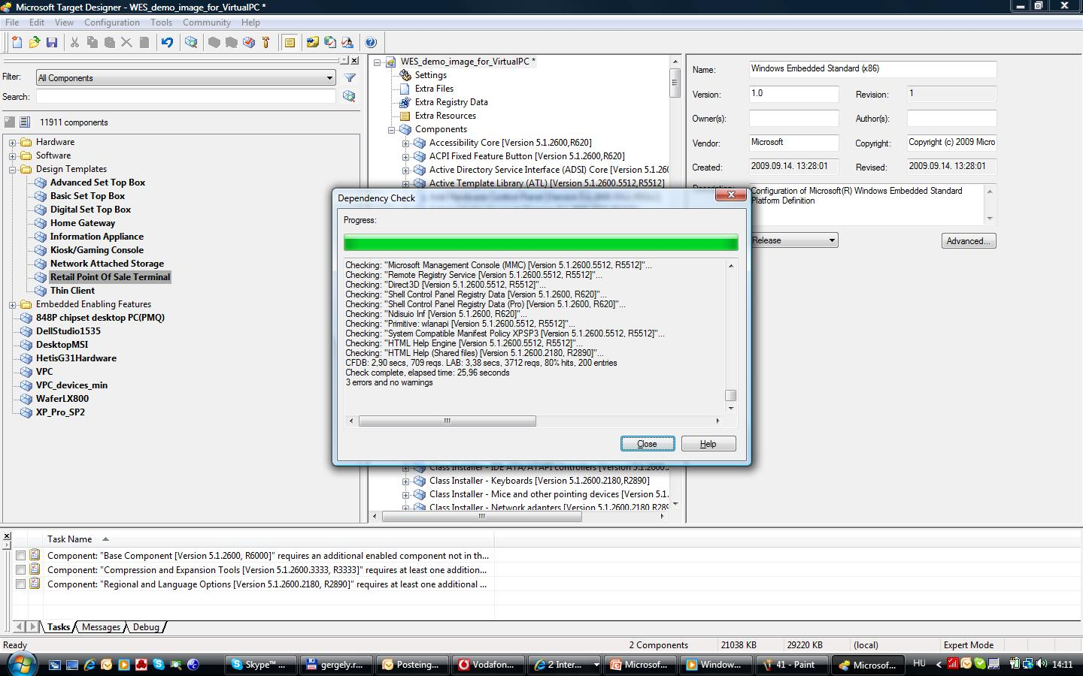
Windows Embedded Standard Target Designer DEMO screenshot

Slide 40
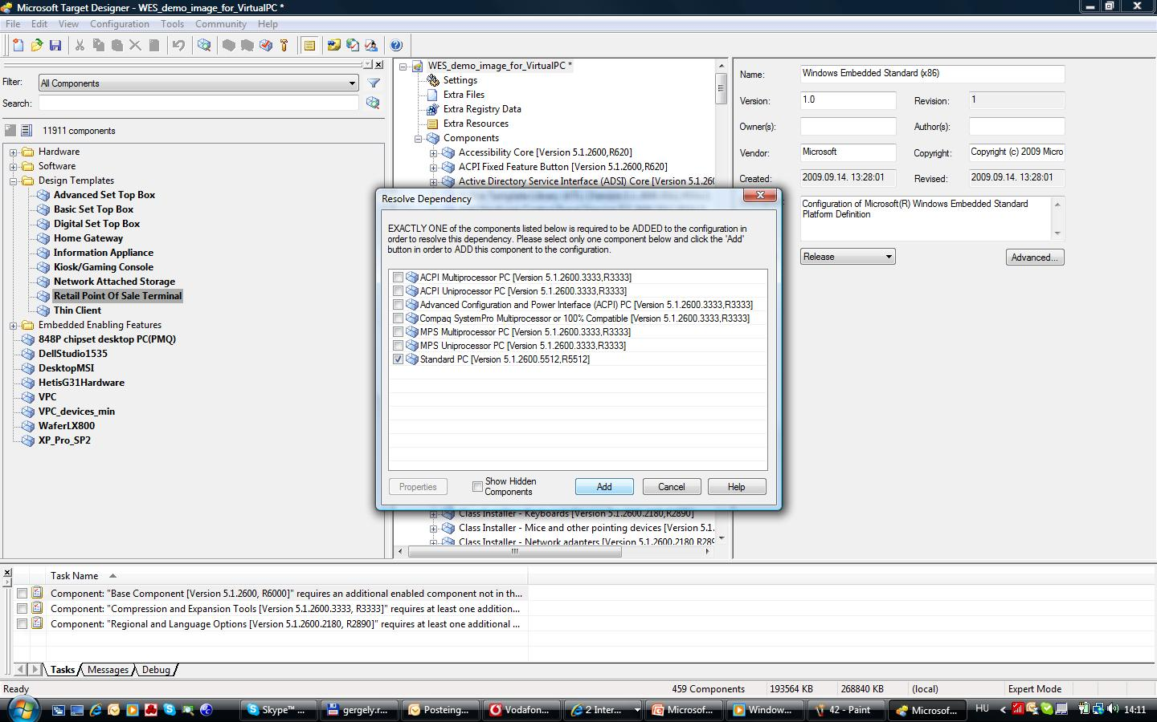
Windows Embedded Standard Target Designer DEMO screenshot

Slide 41
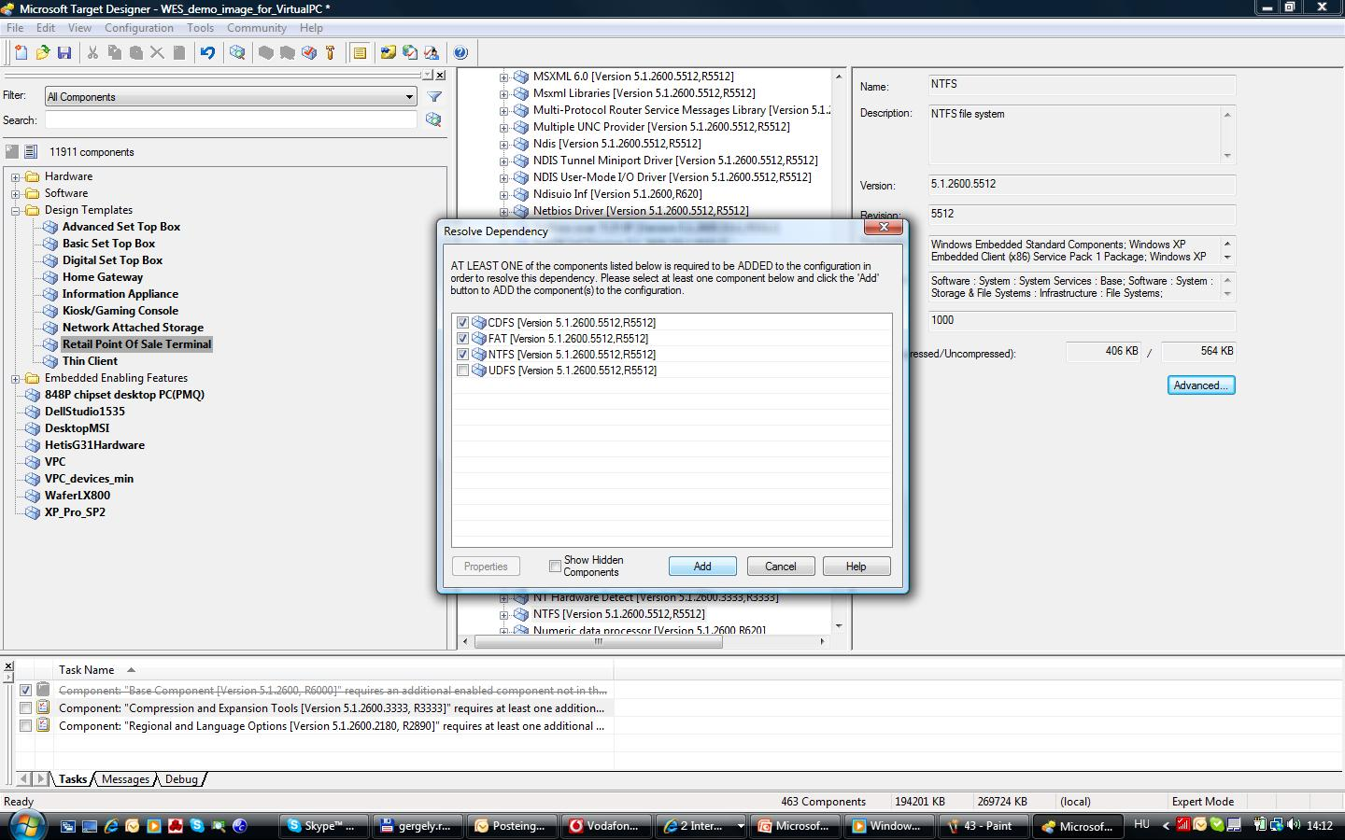
Windows Embedded Standard Target Designer DEMO screenshot

Slide 42
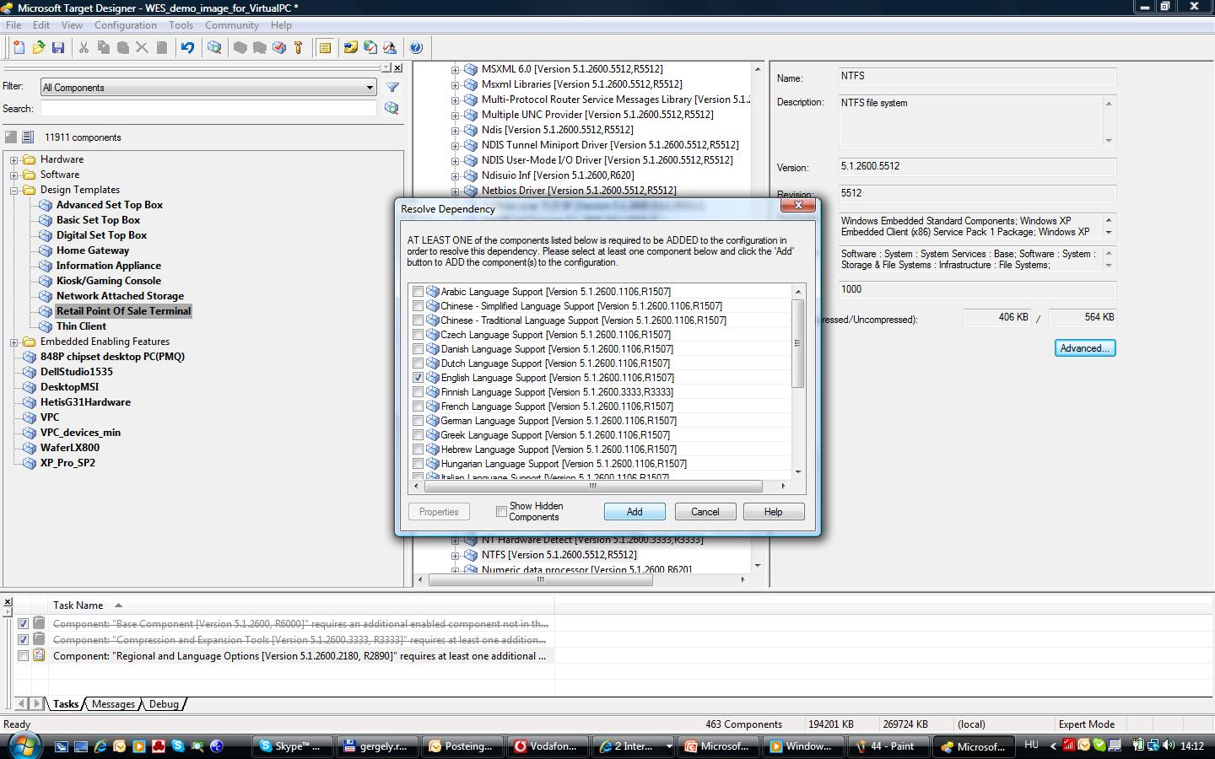
Windows Embedded Standard Target Designer DEMO screenshot

Slide 43
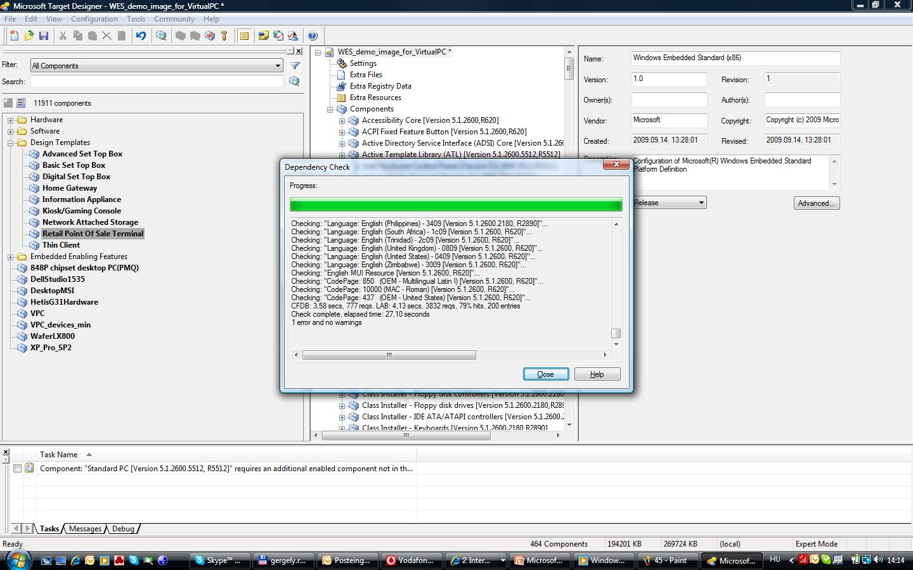
Windows Embedded Standard Target Designer DEMO screenshot

Slide 44
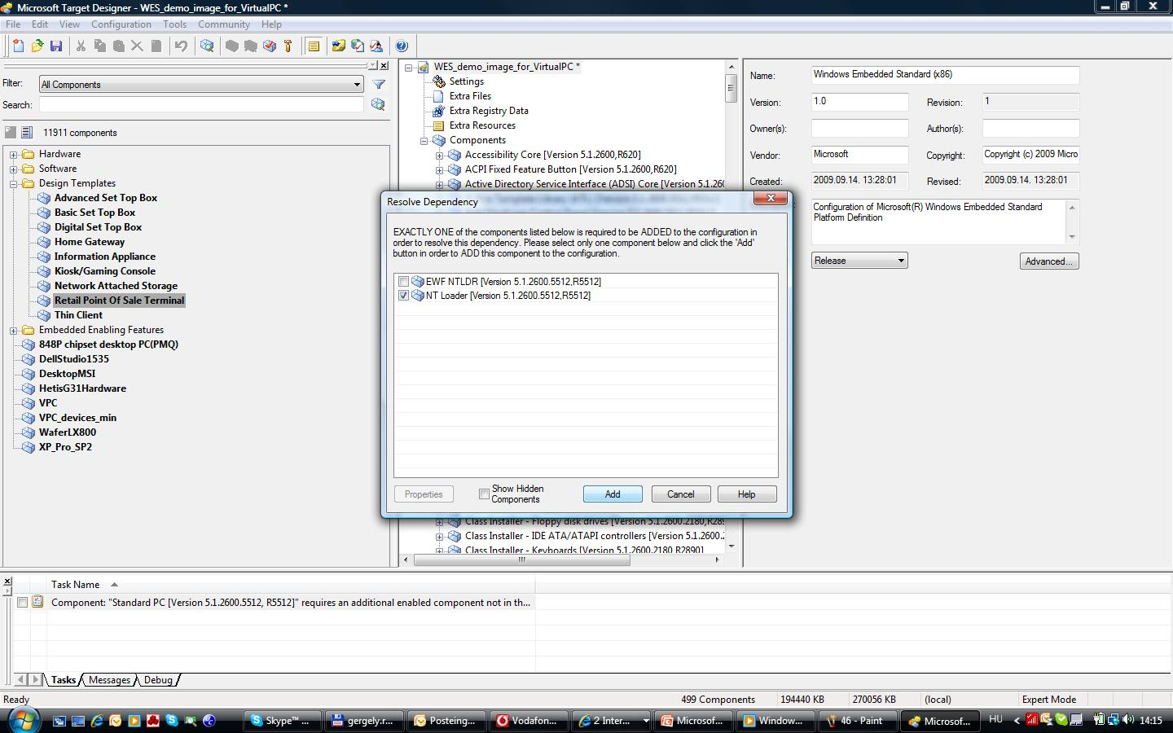
Windows Embedded Standard Target Designer DEMO screenshot

Slide 45
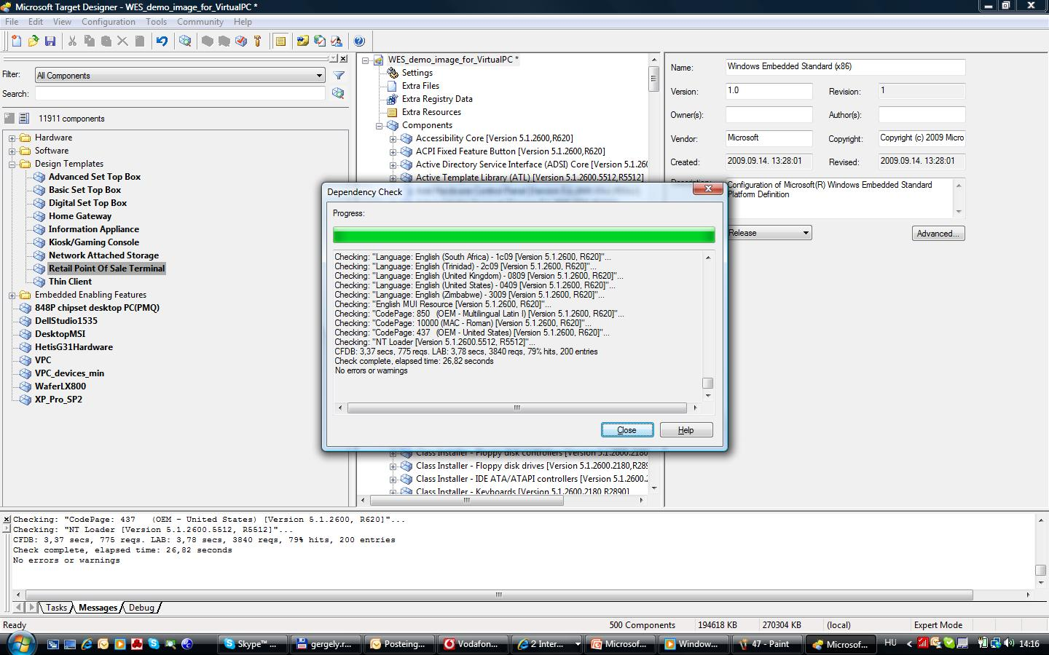
Windows Embedded Standard Target Designer DEMO screenshot

Slide 46
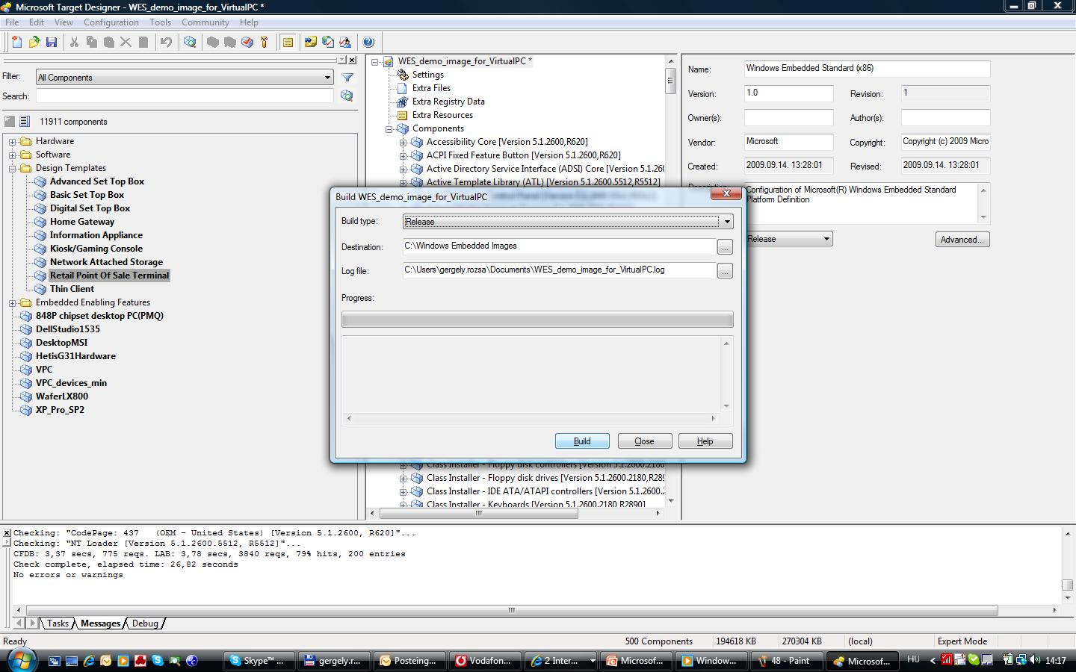
Windows Embedded Standard Target Designer DEMO screenshot

Slide 47
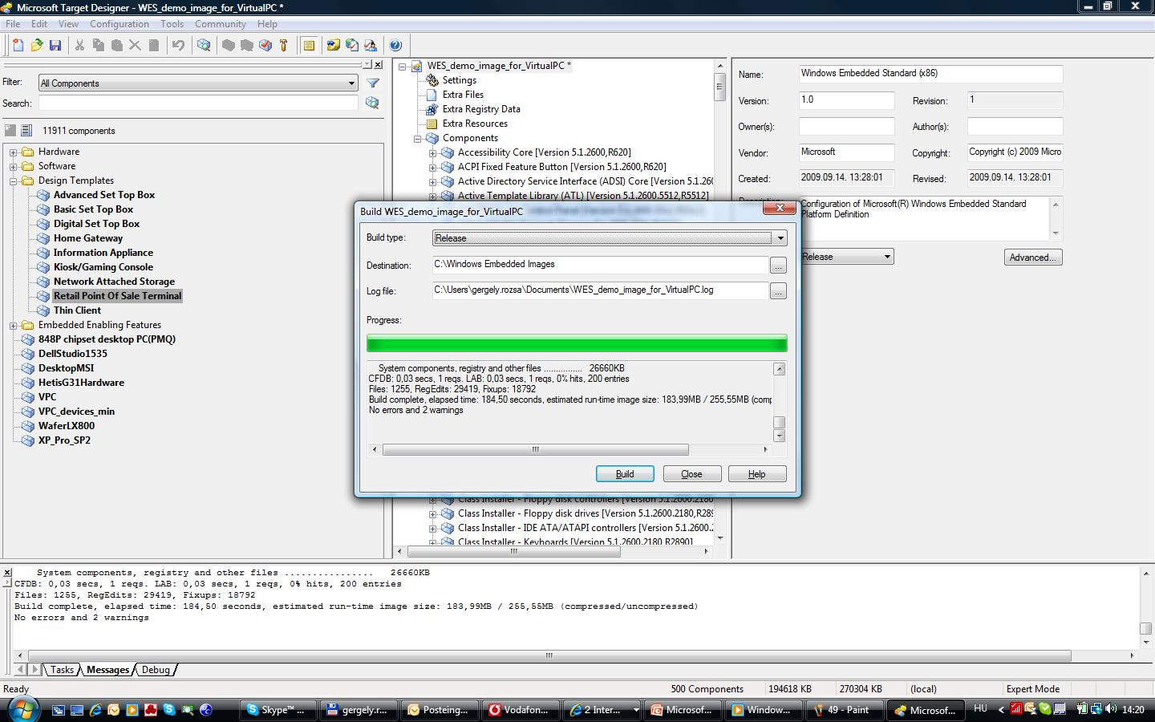
Windows Embedded Standard Target Designer DEMO screenshot

Slide 48
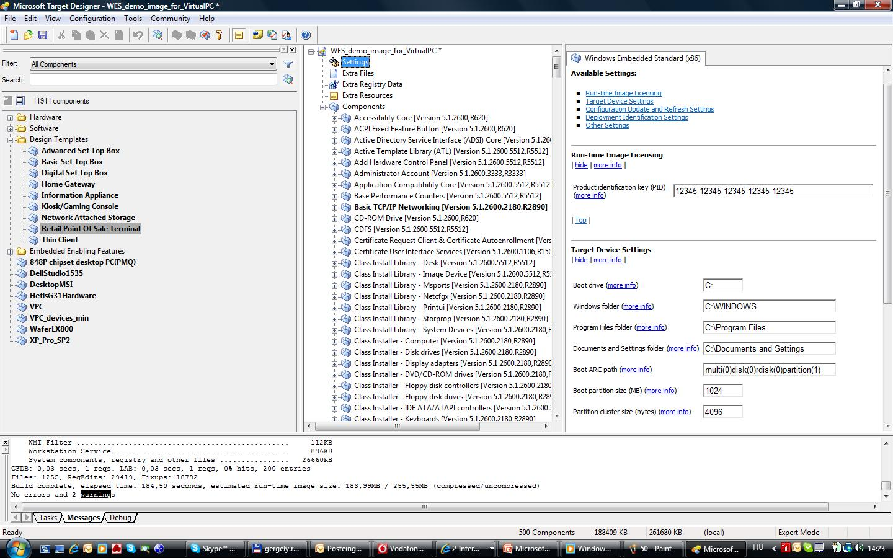
Windows Embedded Standard Target Designer DEMO screenshot

Slide 49
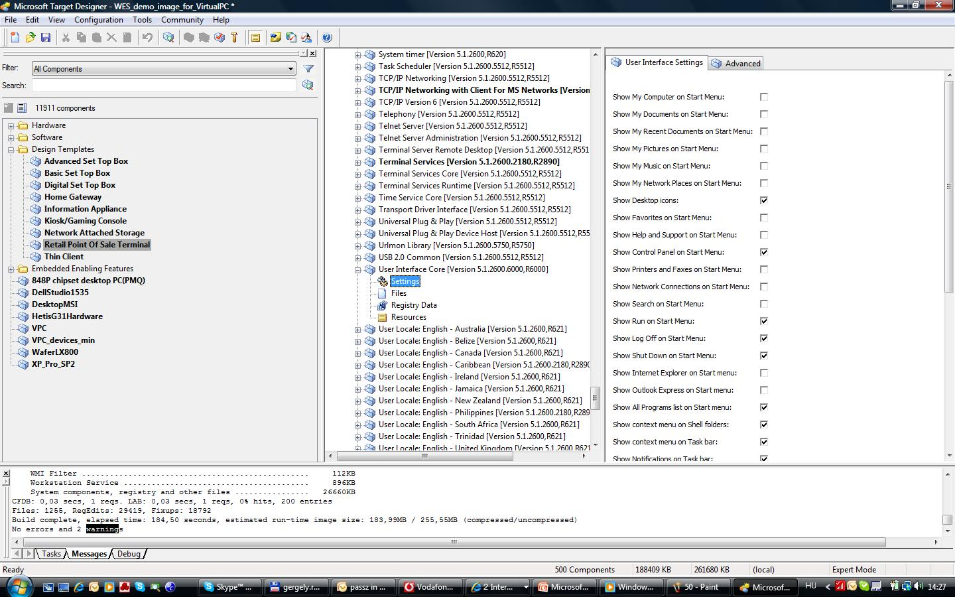
Windows Embedded Standard Target Designer DEMO screenshot

Slide 50
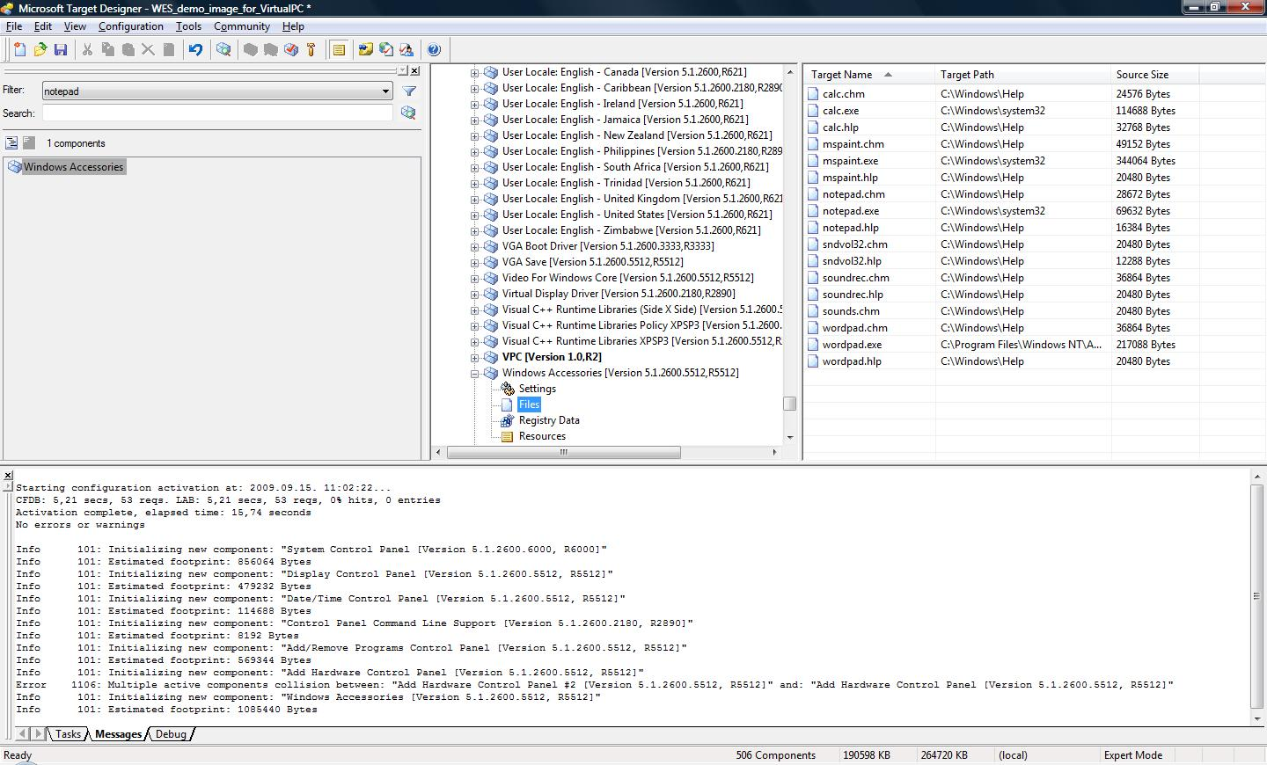
Windows Embedded Standard Target Designer DEMO screenshot

Slide 51
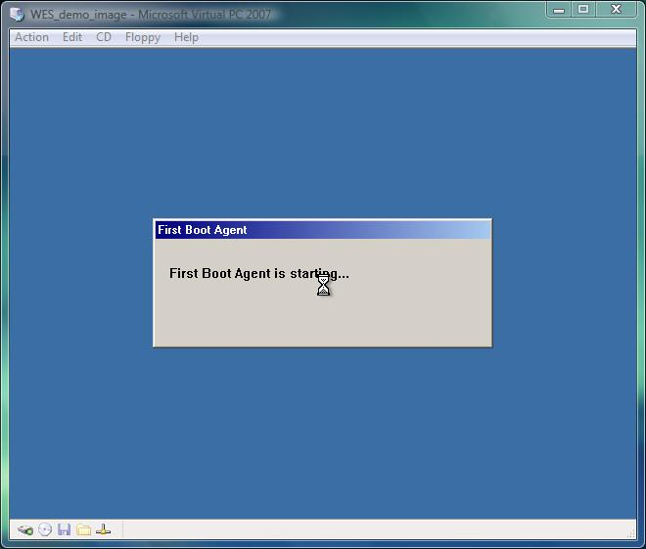
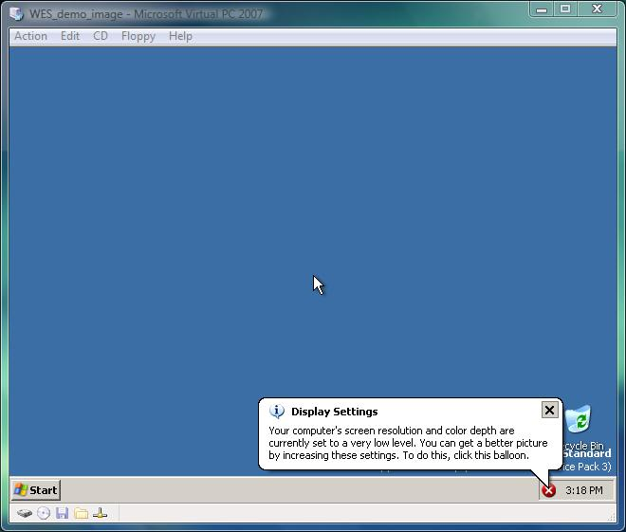
Windows Embedded Standard Target Designer DEMO screenshot

Slide 52
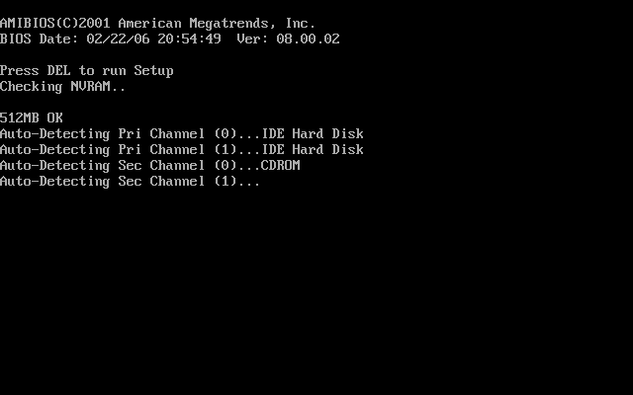

Windows Embedded Standard DEMO

Slide 53


Custom Bootlogo
Create a 640x480 16 color bitmap
Save as Boot.bmp in Windows directory
Edit boot.ini
  Add /NOGUIBOOT /BOOTLOGO

Slide 54
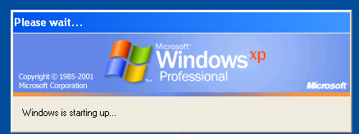
Minlogon
Removes the Windows Logon Windows
Removes Windows is loading screen
Uses SYSTEM account
No Domainparticipation possible
No Userlogin possible

Slide 55
Custom Shell
[HKEY_LOCAL_MACHINE\Software\Microsoft\Windows NT\CurrentVersion\Winlogon]
Shell=<absolute path to application>
How?
Create a registry entry in your image in Target Designer
Create a custom component for your application with the registry entry included
Change it later in the final image

Slide 56



Windows Embedded – Tools
TA / TAP
Image Diff Engine
Windows PE – Windows Preinstallation Environment (WAIK)

Slide 57

Image Diff Engine
Tool to update existing images
Allows update from SP2 to SP3 in the field
Compares two images and saves only the differences
  Files
  Registry
-
=

Slide 58
Image Diff Engine
Difference is saved in a single directory including a XML file describing all changes
The extracted changes can be applied to a running image
  After a reboot the image runs with all changes
IDIFF.exe
  Used to create the difference output
IDA.exe
  Used to update an existing image with the extracted information

Slide 59

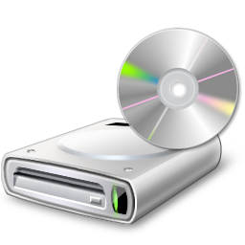
Windows Embedded – Windows PE
Windows Preinstallation Environment
Bootable Mini Windows
Diskpreparation
Image Transfer

Slide 60
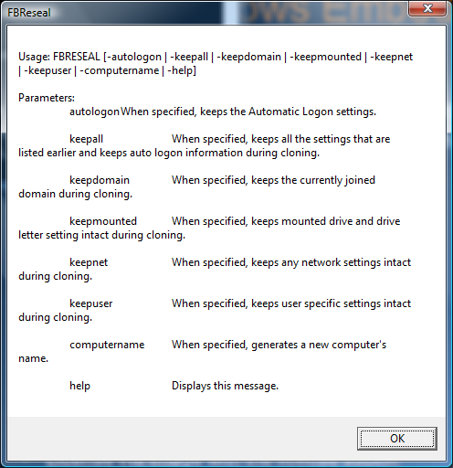
System Cloning Tool
Fbreseal.exe
  Removes all unique Ids
  User SIDs
  Computername
  Networksettings
  Autologon
Important if you use the same image in the same network

Slide 61

Add the OEM information
Create a file oeminfo.ini in c:\windows\system32 folder.
Oeminfo.ini
[Version]
Microsoft Windows XP and the Windows .NET Server family
WinVer=5.01
[General]
Manufacturer=Fabricam
Model=DEMOPC
[Support Information]
Line1="Call +44-118-909-2480"

Slide 62

Add OEM Logo and details
Create a bitmap file, Oemlogo.bmp, that contains your company logo. The bitmap must be 172 x 100 pixels in size. Place the file in the \Windows\System32\ folder.

Slide 63
Capture/apply an image using ImageX
Capture:
Boot WinPE using WDS or an USB HDD
Type imagex /capture c: c:\images\winxp.wim “DEMOPC 1000”
(z: is the share or letter of the USB HDD)
Apply:
Prepare the disk using diskpart and the scrip used for installation:
diskpart /s diskprep.txt
Format the drive.
Apply the nt52 boot sector to the drive:
x:\tools\bootsect.exe /NT52 C:
Apply the image:
imagex /apply z:\images\winxp.wim 1 c:

Slide 64
Customisation
Hide Windows XP startup splash logo
Add the switch “/noguiboot” to the default entry in the Boot.ini This switch disables the bitmap that displays the progress bar for Windows XP Professional startup
multi(0)disk(0)rdisk(0)partition(1)\WINNT="Microsoft Windows XP Professional" /fastdetect /noguiboot
Adding the “/bootlogo” switch to the end of the default entry line shown above will show the bitmap located at %systemroot%\boot.bmp, provided it is a 640x480, 16 color bitmap.
Change colors of logon screens
logon screen background should be set to black by adding a value of 0 0 0 to the following registry values:
HKEY_USERS\.DEFAULT\Control Panel\Colors\Background
HKEY_LOCAL_MACHINE\SOFTWARE\Microsoft\WindowsNT\CurrentVersion\
Winlogon\Background

Slide 65

Customisation
Hide Windows Fatal Error Messages
When a STOP message (a fatal system error message) displays in Windows XP, the computer enters debug mode for troubleshooting purposes. The error message appears on a blue screen, and the first few lines are similar to the following sample error message:
Stop 0x0000001e (c000009a 80123f36 02000000 00000246)
Unhandled Kernel exception c000009a from 8123f26
Address has base at 80100000 ntoskrnl.exe
If such an event occurs, the computer can be configured to restart automatically through the Startup and Recovery options. This approach would effectively prevent the device from remaining on the blue screen (and the cryptic information it displays) until physical intervention is arranged.
This setting can also be configured through the following registry change:-
System Key:[HKEY_LOCAL_MACHINE\SYSTEM\CurrentControlSet\Control\CrashControl]
Value Name: AutoReboot
Data Type: REG_DWORD (DWORD Value)
Value Data: (0 = disabled, 1 = auto reboot)
OR you can simply set the checkbox on Target Designer „User interface core” component’s settings window. (If you want to acchieve automatical restart after BSOD...)

Slide 66
Customisation
Suppress Pop-up Messages
Suppressing pop-up messages is a key concern for a device. The following recommendations can help suppress pop-ups:
Disable the messenger service on the device
Disable the error reporting service on the device
Disable Dr. Watson pop-ups using HKEY_LOCAL_MACHINE\SOFTWARE\Microsoft\DrWatson\VisualNotification=0
Suppress pop-up error messages using HKEY_LOCAL_MACHINE\SYSTEM\CurrentControlSet\Control\Windows\ErrorMode=2
Disable startup error messages using HKEY_LOCAL_MACHINE\SOFTWARE\Microsoft\WindowsNT\CurrentVersion\Windows\NoPopUpsOnBoot=1

Slide 67



Slide 68

Windows Embedded Standard Evaluation
Get a free 120-Day Evalation Kit from us!
Fully functional
Saved configuration is
fully compatible to
full version

Slide 69
Windows Embedded Standard 7
Based on Windows 7 Ultimate (mostly all Ultimate Features)
Splitted to more than hundred Feature Packs
X86 and x64 architectures supported
Direkt setup to the target device (Image Build Wizard, IBW)
Unattended Setup (Image Configuration Editor, ICE)

Slide 70


Windows Embedded Standard 7
Main Features:
  Language Packs
  Bitlocker
  Bitlocker To Go
  Direct Access
  Applocker
  Branch Cache
  Multitouch
  VHD Boot
  DISM
  Windows Update

Slide 71

Windows Embedded Standard 7
Embedded Enabling Features:
  Enhanced Write Filter
  Hibernate Once Resume Many
  File Based Write Filter
  Registry Filter
  USB Boot
  Custom shell
  (MessegaBox autoreply, Dialog Blocker, Branding)

Slide 72

Windows Embedded Standard 7
Image Build Wizard (IBW)
  Standalone Setup (no tools like TD, PB)
  Bootable Setup DVD
  Binaries for both x86 and x64
  Direct install to the target machine
  Interactive and unattended setup

Slide 73

Windows Embedded Standard 7
Image Configuration Editor (ICE)
  Install to the developer PC
    .NeET FW
    Tool for creating automated script data (unattended files)
        XML based

Slide 74
Windows Embedded Standard 7
Questions….

