Slide 1

Summary and Q&A
Rafal Lukawiecki
Strategic Consultant, Project Botticelli Ltd
rafal@projectbotticelli.com

Slide 2
Want Powerful BI Applications?
You should have a Data Warehouse
Want BI Apps quickly?
  PowerPivot
Want great self-service BI?
  Ensure good dimensional design:
    Easy to understand for a knowledge worker
    Flexible
    Correct and aligned

Slide 3
Three Contexts of BI Use
1
Personal BI
Built by me, for me, used only by me
2
Team BI
Built by someone on the team, shared inside a team
3
Organizational BI
Built and maintained by IT, for use across company

Slide 4
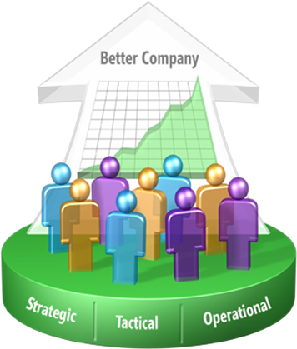

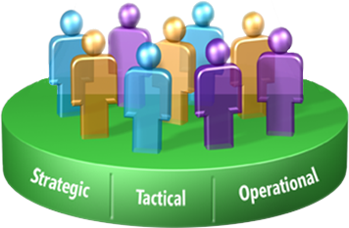

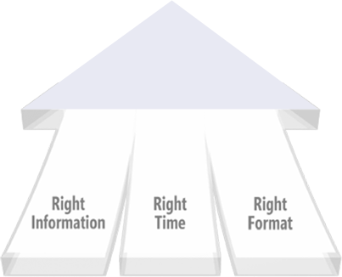

Microsoft Business Intelligence
End-to-End BI for Everyone
Business User Experience
Business Collaboration Platform
Data Infrastructure & BI Platform

Slide 5

Resources
Project Botticelli at your service!
  Training, mentoring, “do-it-with-you” on-the-job assistance with all BI and SQL needs
  Email me at rafal@projectbotticelli.com
Home: www.microsoft.com/bi
IDV Visual Fusion: Mark.Morrison@idvsolutions.com
Demos on www.powerpivot.com, www.powerpivotgeek.com, www.sqlserveranalysisservices.com, www.sqlserverdatamining.com,
www.codeplex.com
More demos and sessions at www.microsoft.com/technetspotlight

Slide 6
Q & A

Slide 7

Thank You.
© 2010 Microsoft Corporation & Project Botticelli Ltd. All rights reserved.
The information herein is for informational purposes only and represents the opinions and views of Project Botticelli and/or Rafal Lukawiecki. The material presented is not certain and may vary based on several factors. Microsoft makes no warranties, express, implied or statutory, as to the information in this presentation.
Portions © 2010 Project Botticelli Ltd & entire material © 2010 Microsoft Corp. Some slides contain quotations from copyrighted materials by other authors, as individually attributed or as already covered by Microsoft Copyright ownerships. All rights reserved. Microsoft, Windows, Windows Vista and other product names are or may be registered trademarks and/or trademarks in the U.S. and/or other countries. The information herein is for informational purposes only and represents the current view of Project Botticelli Ltd as of the date of this presentation. Because Project Botticelli & Microsoft must respond to changing market conditions, it should not be interpreted to be a commitment on the part of Microsoft, and Microsoft and Project Botticelli cannot guarantee the accuracy of any information provided after the date of this presentation. Project Botticelli makes no warranties, express, implied or statutory, as to the information in this presentation. E&OE.

