Slide 1
Windows Embedded Standard 7
Componentized version of Windows 7

Slide 2
Windows Embedded Standard 7
Based on Windows 7 Ultimate (mostly all Ultimate Features)
Splitted to more than hundred Feature Packs
x86 and x64 architectures supported
Direkt setup to the target device (Image Build Wizard, IBW)
Unattended Setup (Image Configuration Editor, ICE)

Slide 3
Windows Embedded Standard 7
HW requirements
1 GHz x86 or AMD64 processor with 900 mhz speed or equivalent
512 MB of system memory (1GB recommended for AMD64)
1 GB free space on hard disk drive (HDD) or flash-based Solid State Drive (SSD) (4 GB recommended)
At least one of the following bootable media types:
  Bootable DVD-ROM drive
  Bootable USB 2.0 port and a USB Flash Drive (UFD) with 4 GB of free space, or access to a local network
BIOS Supporting Windows Preinstallation Environment (Windows PE) 3.0

Slide 4
Windows Embedded Standard 7
HW requirements for development PC
Supported operating systems:
Vista SP1, Vista SP2, Server 2008 R2, Windows 7
Needed SW features:
  Microsoft .NET Framework 2.0 or higher
  Microsoft Core XML Services (MSXML) 6.0 or higher

Slide 5
Windows Embedded Standard 7
Toolkits (RC available)
www.microsoft.com/embedded
Standard_2011_Toolkit.iso
Standard_2011_32bit_Bootable_IBW.iso
Standard_2011_64bit_Bootable_IBW.iso
Tap.exe

Slide 6
Windows Embedded Standard 7 eCORE
Support for TCP/IP, IPV4/6, DHCP, HTTP, DNS Client, NETBIOS, and SMB/CIFS.
Windows cryptography APIs, including local security authority (LSA) authentication, credentials management, Winlogon, and authorization.
Basic APIs for the Windows graphics system.
Support for Plug and Play hardware.
Support for servicing through Component Based Servicing (CBS) and package manager.
Note: UAC is turned off.

Slide 7

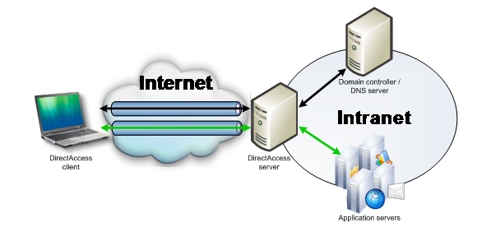
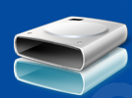
Windows Embedded Standard 7
Main Features:
  Language Packs
  Bitlocker
  Bitlocker To Go
  Direct Access
  Applocker
  Branch Cache
  Multitouch
  VHD Boot
  DISM
  Windows Update

Slide 8
Windows Embedded Standard
Language Support
de-DE Language Pack
en-US Language Pack
es-ES Language Pack
fr-FR Language Pack
it-IT Language Pack
jp-JP Language Pack
zh-CN Language Pack
zh-TW Language Pack

Slide 9
Windows Embedded Standard
DISM functionality
WINDOWS EDITION SERVICING
UNATTEND SERVICING
DRIVER SERVICING
INTERNATIONAL SERVICING
APPLICATION SERVICING
PACKAGE SERVICING

Slide 10

Windows Embedded Standard 7
Embedded Enabling Features:
  Enhanced Write Filter
  Hibernate Once Resume Many
  File Based Write Filter
  Registry Filter
  USB Boot
  Custom shell
  (MessegaBox autoreply, Dialog Blocker, Branding)

Slide 11
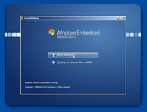
Windows Embedded Standard 7
Image Build Wizard (IBW)
  Standalone Setup (no tools like TD, PB)
  Bootable Setup DVD
  Binaries for both x86 and x64
  Direct install to the target machine
  Interactive and unattended setup

Slide 12
Windows Embedded Standard 7
IBW image generation
Start IBW on the device.
Select Build an Image on the Install Windows page.
Accept license terms
Select language, time, keyboard settings.
Add inbox drivers on the Target Analysis page.
Add needed feautres.
Click Resolve, to see the depending components.
Select the drive to install to, and add new drivers if needed.

Slide 13
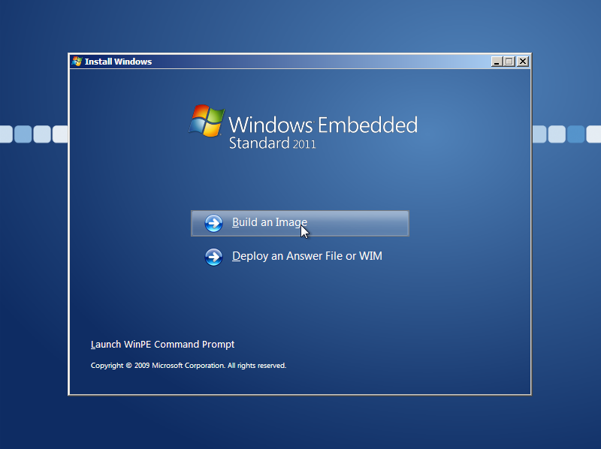
Windows Embedded Standard 7
IBW image generation

Slide 14
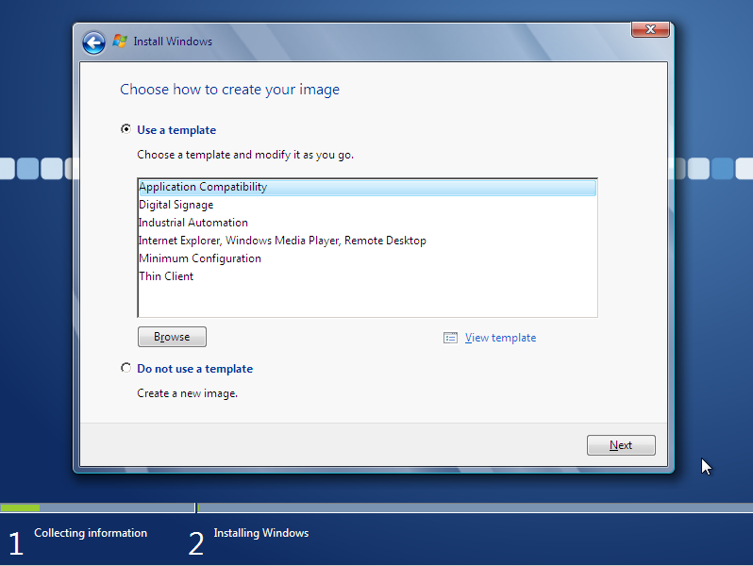
Windows Embedded Standard 7
IBW image generation

Slide 15
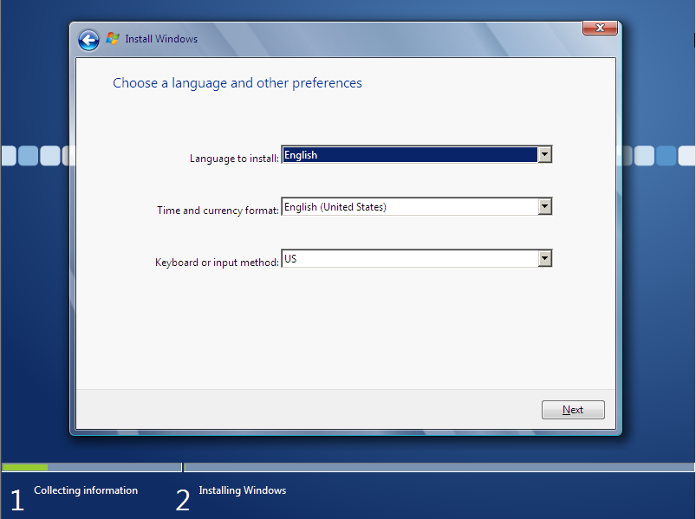
Windows Embedded Standard 7
IBW image generation

Slide 16
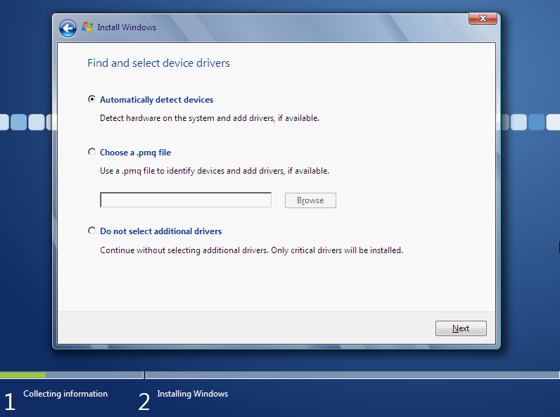
Windows Embedded Standard 7
IBW image generation

Slide 17
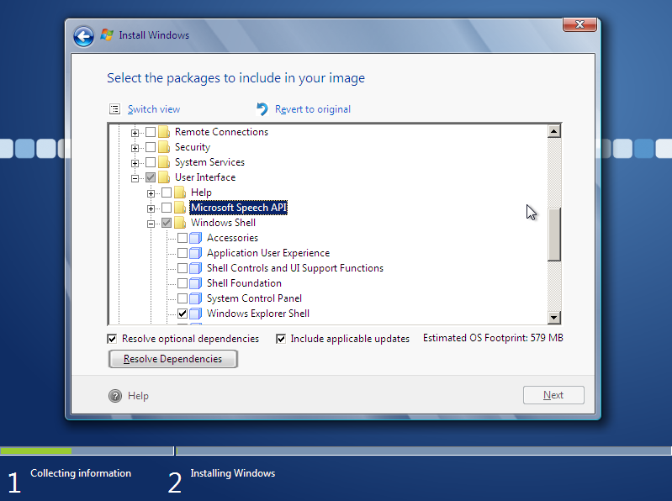
Windows Embedded Standard 7
IBW image generation

Slide 18
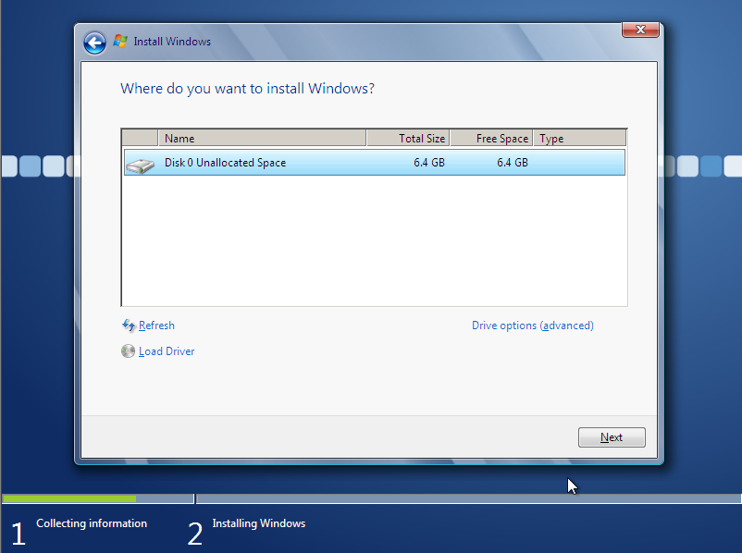
Windows Embedded Standard 7
IBW image generation

Slide 19
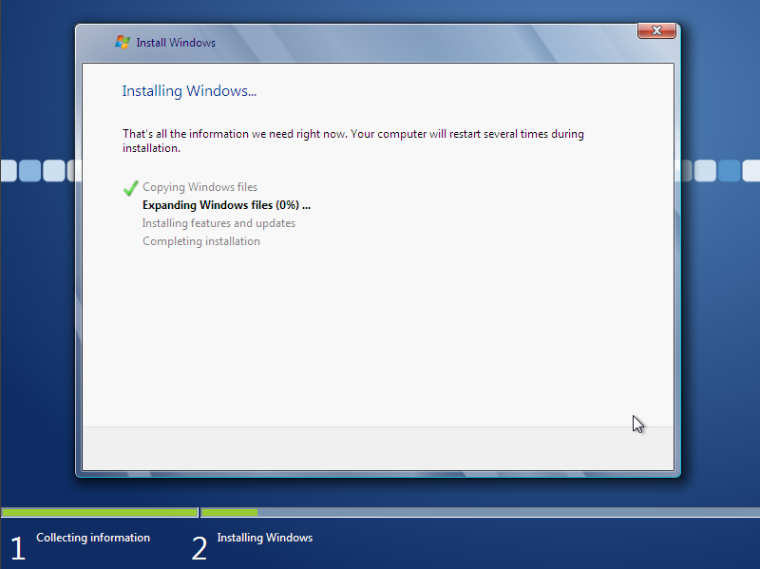
Windows Embedded Standard 7
IBW image generation

Slide 20
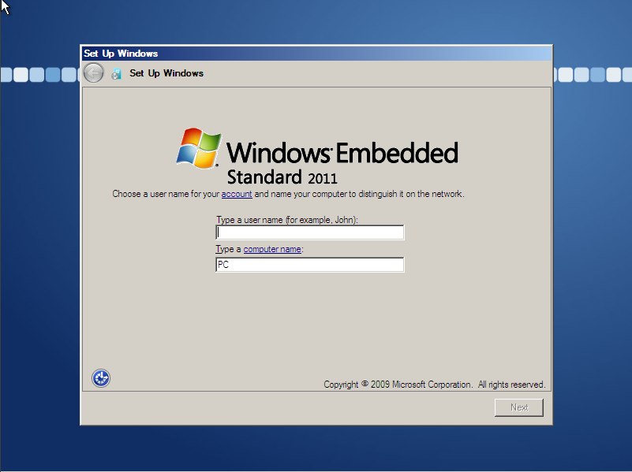
Windows Embedded Standard 7
IBW image generation

Slide 21
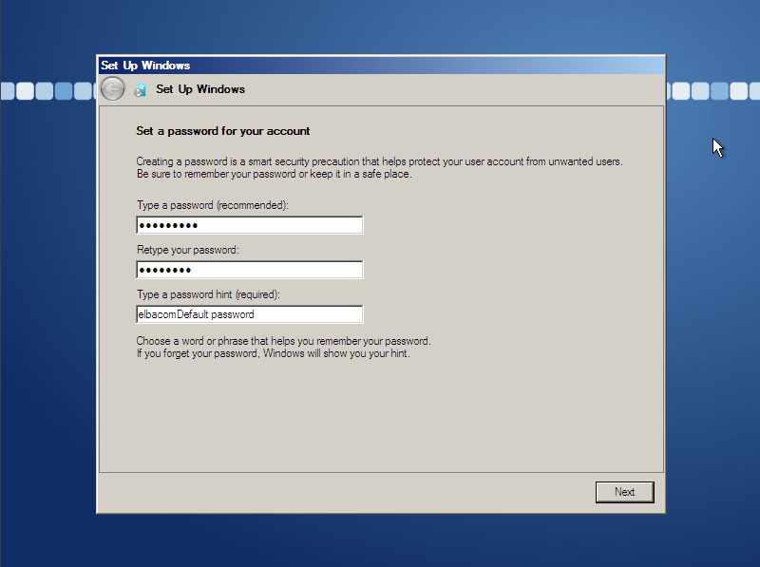
Windows Embedded Standard 7
IBW image generation

Slide 22
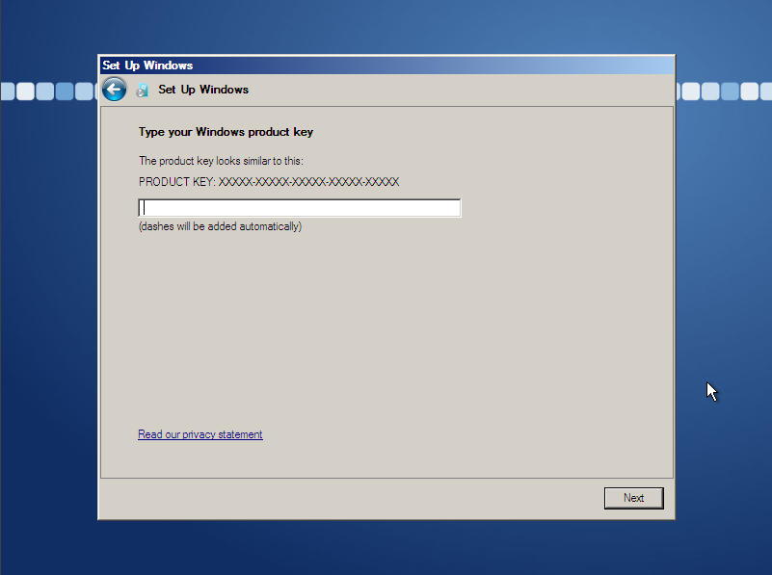
Windows Embedded Standard 7
IBW image generation

Slide 23
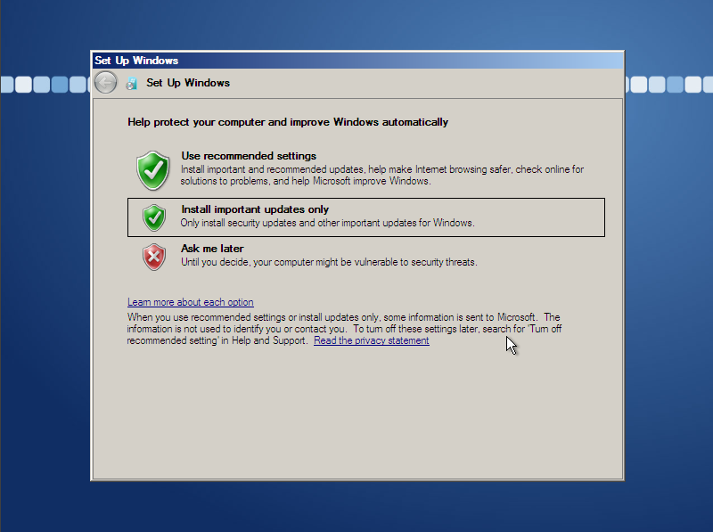
Windows Embedded Standard 7
IBW image generation

Slide 24
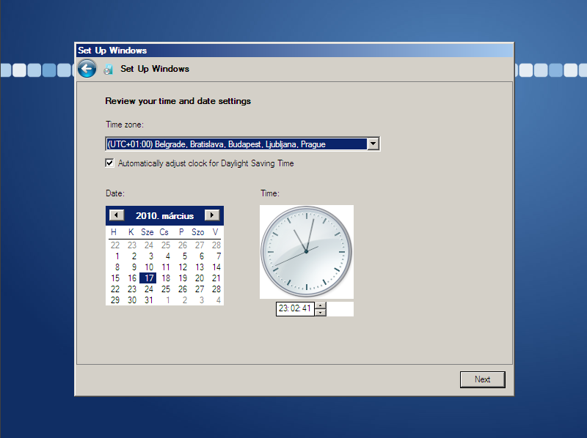
Windows Embedded Standard 7
IBW image generation

Slide 25
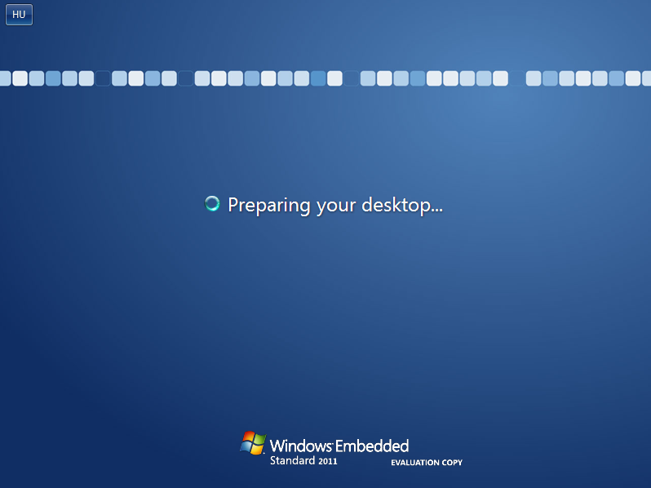
Windows Embedded Standard 7
IBW image generation

Slide 26
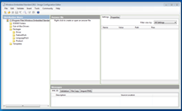
Windows Embedded Standard 7
Image Configuration Editor (ICE)
  Install to the developer PC
    .Net FW
    Tool for creating automated script data (unattended files)
        XML based

Slide 27
Windows Embedded Standard 7
HW+SW dependencies
Import *.PMQ file to ICE, to resolve hardware dependencies.
Tools / Analyze Static Dependencies
Open files to analyze.

Slide 28
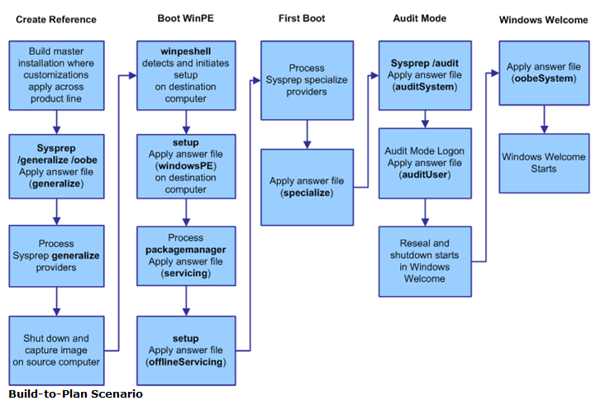
Windows Embedded Standard 7
Boot process

Slide 29
Windows Embedded Standard 7
Install process
Start the Standard 2011 product DVD.
Image Builder starts and the windowsPE and offlineServicing passes run.
After the Standard 2011 image is copied to the hard disk, the system restarts and Image Builder runs the specialize pass.
After Image Builder finishes, the oobeSystem configuration pass runs and Windows Welcome starts.
After you install Standard 2011, run sysprep /audit to start in audit mode. In audit mode, you can add applications, device drivers, and make other customizations. You can also test the computer and verify that all components are working correctly.
In audit mode, the auditSystem and auditUser configuration passes run.
After you update the Standard 2011 installation, run sysprep /oobe /generalize.

Slide 30
Windows Embedded Standard 7
Create custom install disc
Create a customized image with ICE.
Generate a custom folder ( For example: C:\utildisk\ISO ) with the necessary files (Tools/Create Media)
Start the Windows PE Tools Command Prompt
Create a bootable disc imaghe with oscdimg.
oscdimg -n -bc:\utildisk\etfsboot.com C:\utildisk\ISO C:\utildisk\util_x86.iso
Burn the ISO to a disc.

Slide 31
Windows Embedded Standard 7
Create custom install USB
The same process as on the previous slide, but instead oscdimg, the following steps:
  Partition, format and activate the USB drive.
For example with using diskpart.exe:
diskpart
select disk 1
clean
create partition primary size=<device_size>
select partition 1
active
format fs=fat32
assign
exit

Slide 32
Windows Embedded Standard 7
Cloning
The same process as on the previous slide, but instead oscdimg, the following steps:
  Partition, format and activate the USB drive.
For example with using diskpart.exe:
diskpart
select disk 1
clean
create partition primary size=<device_size>
select partition 1
active
format fs=fat32
assign
exit

Slide 33
Windows Embedded Standard 7
Questions….

